Slide 1
The Institute of Earth and Space Science (IESS) Strategy
2026–2030
www.kacst.gov.sa

Slide 2


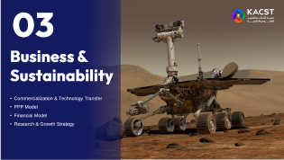
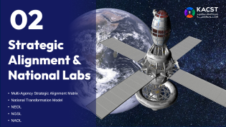
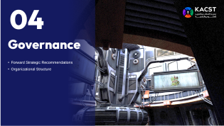
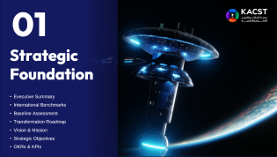
Table of
Content
Within this context, the Earth & Space Science Institute (IESS) emerges, after a 40‑year track record of scientific achievement, as a sovereign enabler for building a national space ecosystem driven by research, development, and innovation. This strategy aligns with KACST 2030 directions and positions the Institute to evolve from a traditional research center into a national platform for high‑precision geospatial data, advanced space technologies, and innovation‑led production.

Slide 3


01
Strategic Foundation
Executive Summary
International Benchmarks
Baseline Assessment
Transformation Roadmap
Vision & Mission
Strategic Objectives
OKRs & KPIs

Slide 4

Executive Summary
The Kingdom is undergoing an unprecedented national transformation, where space technologies, geospatial intelligence, and satellite imagery are rapidly becoming foundational pillars for national security, economic competitiveness, and evidence‑based decision‑making. This strategy aligns with KACST 2030 directions and positions the Institute to evolve from a traditional research center into a national platform for high‑precision geospatial data, advanced space technologies, and innovation‑led production.
Current Paradigm
Target Model
The prevailing Research-Based paradigm, characterized by stand-alone scientific publications and isolated pilot projects, must be structurally replaced by an Impact-and-Commercialization Operational Model.
This strategy transitions IESS into an agile, asset-backed commercial enabler feeding directly into Future Economies sector. By transforming its core capability tracks into specialized, high-revenue National Laboratories, IESS will monetize a 40-year satellite imagery archive, build secure autonomous geospatial data layers, and deploy deep-space surveillance assets.
The objective is:
to achieve financial self-sustainability, localize cutting-edge dual-use space technologies, and position the Kingdom as the dominant regional hub for space-based independent infrastructure.

Slide 5
Why Now?
The space economy today exceeds $600 billion and is heading toward a trillion; because relying on global data providers is no longer acceptable given security challenges; and because national transformation projects—from NEOM to mining and energy—depend on accurate space-derived data. The Kingdom now has the infrastructure, sovereign support, and government demand that make this moment ideal to launch.
Economic Return
Security Return
Scientific Return
Launch commercial products (Imagery API, InSAR Dashboard, HD Maps, Digital Twins, SSA Engine), establish 6 spin-off companies, and achieve revenues of SAR 200–250 million by 2030, in addition to reducing spending on foreign data providers and creating high-quality jobs in the space economy.
Cover 100% of Saudi space situational awareness (SSA), provide early warning for natural disasters, monitor borders and critical facilities, and secure sensitive data through national data layers produced and analyzed within the Kingdom.
A 40-year national archive, national research platforms (GeoAI, Digital Twins, Research API), training for 200 Saudi researchers and engineers, and the generation of 40 patents/applied research outputs.

Slide 6

What Sets IESS Apart?
Ownership of space and geospatial infrastructure, the ability to produce and analyze data locally, its location within KACST, an integrated lab model (NEOL – NGSL – NAOL), and its capacity to turn scientific research into commercial exportable products.
Space & Geospatial Infrastructure
Local Data Production & Analysis
Integrated Lab Model
Research-to-Commercial Export

Slide 7
International Benchmarks
Proven global models that balance commercial revenue, providing services, and foundational science across the three core pillars.
Core Pillar
International Benchmark
Operational Model
Earth Observation (NEOL)
DLR (German Aerospace Center) - Remote Sensing Technology Institute
Operates as a dual-use entity. It commercializes high-resolution Satellite images and optical datasets via specialized spin-offs, securing long-term government service-level agreements (SLA) for environmental monitoring while funding its internal deep-learning pipelines.
Geospatial Solutions (NGSL)
Ordnance Survey (OS) / Satellite Applications Catapult (UK)
Transitioned from traditional, static 2D map publishing into a dynamic 3D/4D spatial data engine. It monetizes hyper-precise mobility base-layers and digital twins for smart city infrastructures through open API subscription layers and private developer access models.
Astronomical Observatory (NAOL)
South African Astronomical Observatory (SAAO) & SARAO
Combines global deep-space research partnerships (such as SALT and the Square Kilometre Array) with a highly profitable public astro-economy. They successfully established protected, dark-sky eco-tourism reserves that draw significant international private commercial investment.

Slide 8
Baseline Assessment
An audit of IESS's existing foundational capabilities highlights the substantial assets available to be activated under the new strategy:
The 40-Year Satellite Imagery Archive
Regional Observatory Network
Human Capital Capacity & Qualifications
A continuous, unique chronological geospatial data repository covering the entire Arabian Peninsula.
7 astronomical observatories with their facilities are distributed across several geographical locations throughout the Kingdom.
10 mobile astronomical observatories and special cameras
A specialized technical workforce comprising 10 PhD, 23 Masters, 61 Bachelor, and 62 Diploma.

Slide 9
Gap Analysis and Strategic Transformation Roadmap (2026–2030)
Current Situation
A research-based, task-based academic paradigm focused on standalone publications, operating entirely on static government budgets with unmonetized data assets.
TRANSFORMATION
Target Situation (2030)
An agile, asset-backed commercial enabler and primary technical execution arm, generating 200–250M SAR in annual revenue through autonomous data APIs, localized dual-use technologies, and public-private partnerships.

Slide 10
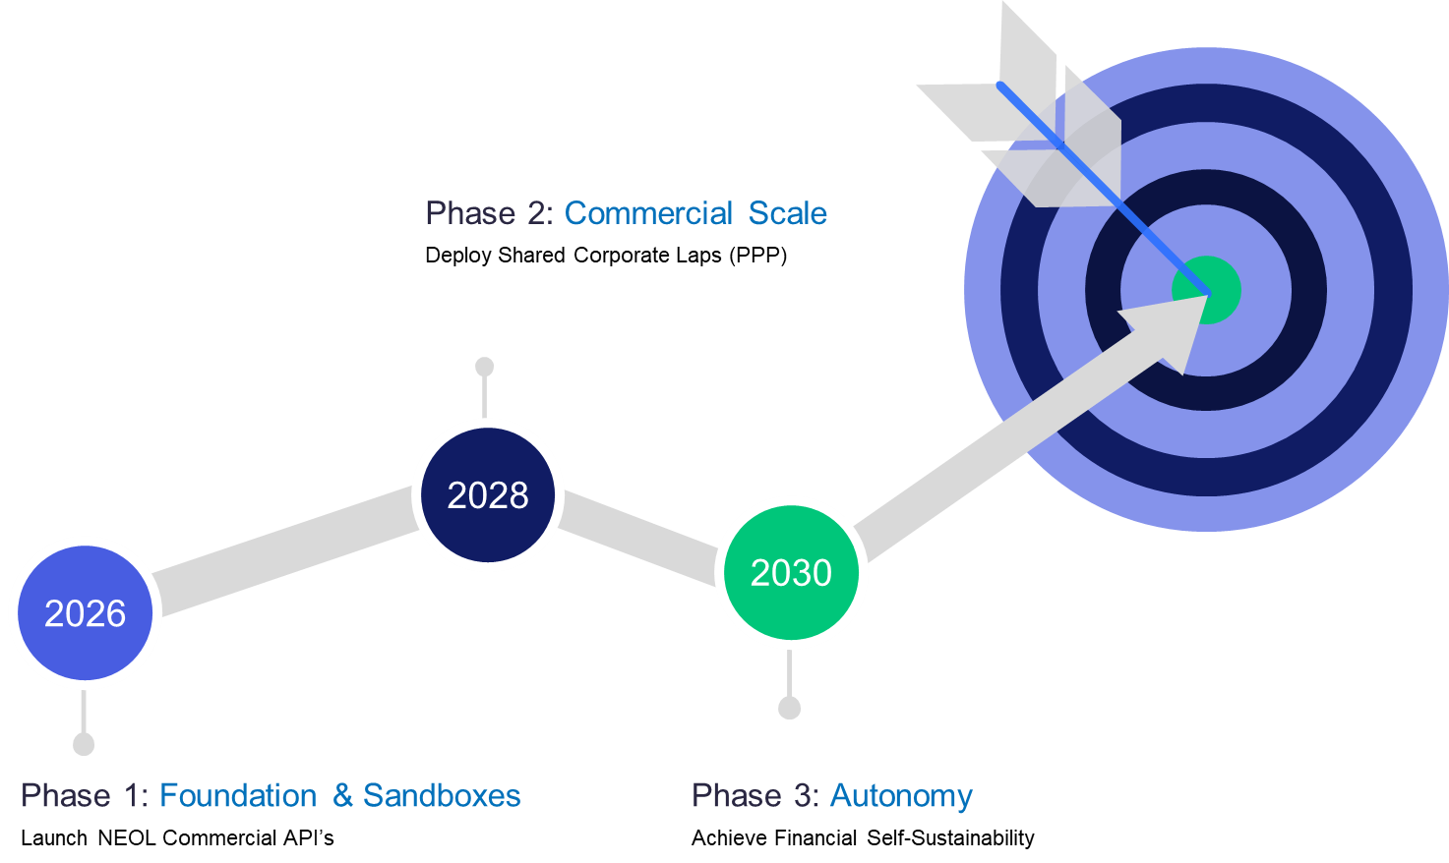
Implementation Timeline and Phases
Phase 1: Foundation, Infrastructure Setup, and Immediate Wins (2026)
1
What is Implemented First: Build and deploy the cloud-native commercial Imagery API to monetize the 40-year satellite archive. Partner directly with the CST to launch the permanent national Regulatory Sandbox for experimental non-terrestrial testing.
Milestones: Complete the granular workforce audit, establish unified metadata standards, and sign initial moon-sighting automation APIs with the Umm Al Qura authority.
2
Phase 2: Commercial Scalability & Private Integration (2027–2028)
Focus: Expand into high-margin downstream business models. Finalize Public-Private Partnership (PPP) frameworks to build Co-Developed Shared Laboratories alongside industrial partners like SAMI and Aramco.
Milestones: Transition lab projects through the ARC Program framework (TRL 4 to TRL 6 validation). Deploy the automated InSAR processing loops for nationwide deformation stacking.
Phase 3: Sovereign Autonomy & Market Dominance (2029–2030)
3
Focus: Achieve full financial self-sustainability and regional sky-sector supremacy. Complete the localization of dual-use technologies (INS gyroscopes and native LEO communication routing payloads).
Milestones: Hit the target commercial revenue of 200M–250M SAR; deliver active data layers to regional smart cities (NEOM, AlUla); support deep-space lunar and Mars rover testing.

Slide 11

Vision & Mission
Vision
To pioneer the regional future economies driven by advanced Earth and Space Science technologies.
Mission
To be the definitive contributor to research, development, and industrial localization that drives the Kingdom's leadership in space. We transform academic ideas into high-margin commercial solutions, localizing advanced space technology and supporting local content.

Slide 12
Strategic Objectives
1
Transition to an Impact and Commercialization Operating Model
Structurally replace the legacy research-only model with specialized, revenue-generating National Laboratories.
2
Maximize and Monetize Data Assets
Turn long-term geospatial archives and automated satellite data feeds into high-margin subscription APIs and early awareness platforms.
Localize Strategic Dual-Use Technologies
Build domestic industrial capacities for small-satellite manufacturing, inertial navigation systems, and sovereign space communication systems.
The objective includes launching the Saudi Space Localization Accelerator (SSLA) program in phases:
3
Knowledge transfer
Building production lines
Training technicians
Prototyping
Quality certification.
4
Adopt Public-Private Partnerships (PPP)
Attract private investments and international space-tech funding through joint venture shared laboratories and data-for-equity frameworks.
5
Build a High-Tier Space Science Cadre
Establish deep technical talent pipelines in artificial intelligence, non-terrestrial cloud architecture, and space sciences through applied academic innovation hubs.

Slide 13
From Tasks to Outcomes: OKRs & KPIs
To shift organizational mindsets from task-based activity to outcome-based accountability, indicators are explicitly mapped to each core objective.
#
Strategic Objective
Key Result (OKR) Target 2030
Key Performance Indicator (KPI)
1
Transition to an Impact and Commercialization Operating Model
Spin out or license at least 5 independent corporate space-tech entities via the ARC framework
Number of active commercial patents transferred or licensed to industry
2
Maximize and Monetize Data Assets
Generate 45% of total institutional revenue through subscription data APIs and dynamic twins
Number of active enterprise API subscriber channels (Civil & Defense)
3
Localize Strategic Dual-Use Technologies
Achieve 60% domestic content sourcing on specialized micro-satellite buses and INS frames
Percentage of localized aerospace manufacturing components produced in-house
4
Adopt Public-Private Partnerships (PPP)
Secure a minimum of 80M SAR in private, non-governmental co-investment matching funds
Value of private capital injected via shared laboratory and data-for-equity frameworks
5
Build a High-Tier Space Science Cadre
Train and certify 500+ national spatial data scientists, remote sensing engineers, and tour guides
Percentage reduction in identified deep technical AI and space law capability gaps

Slide 14
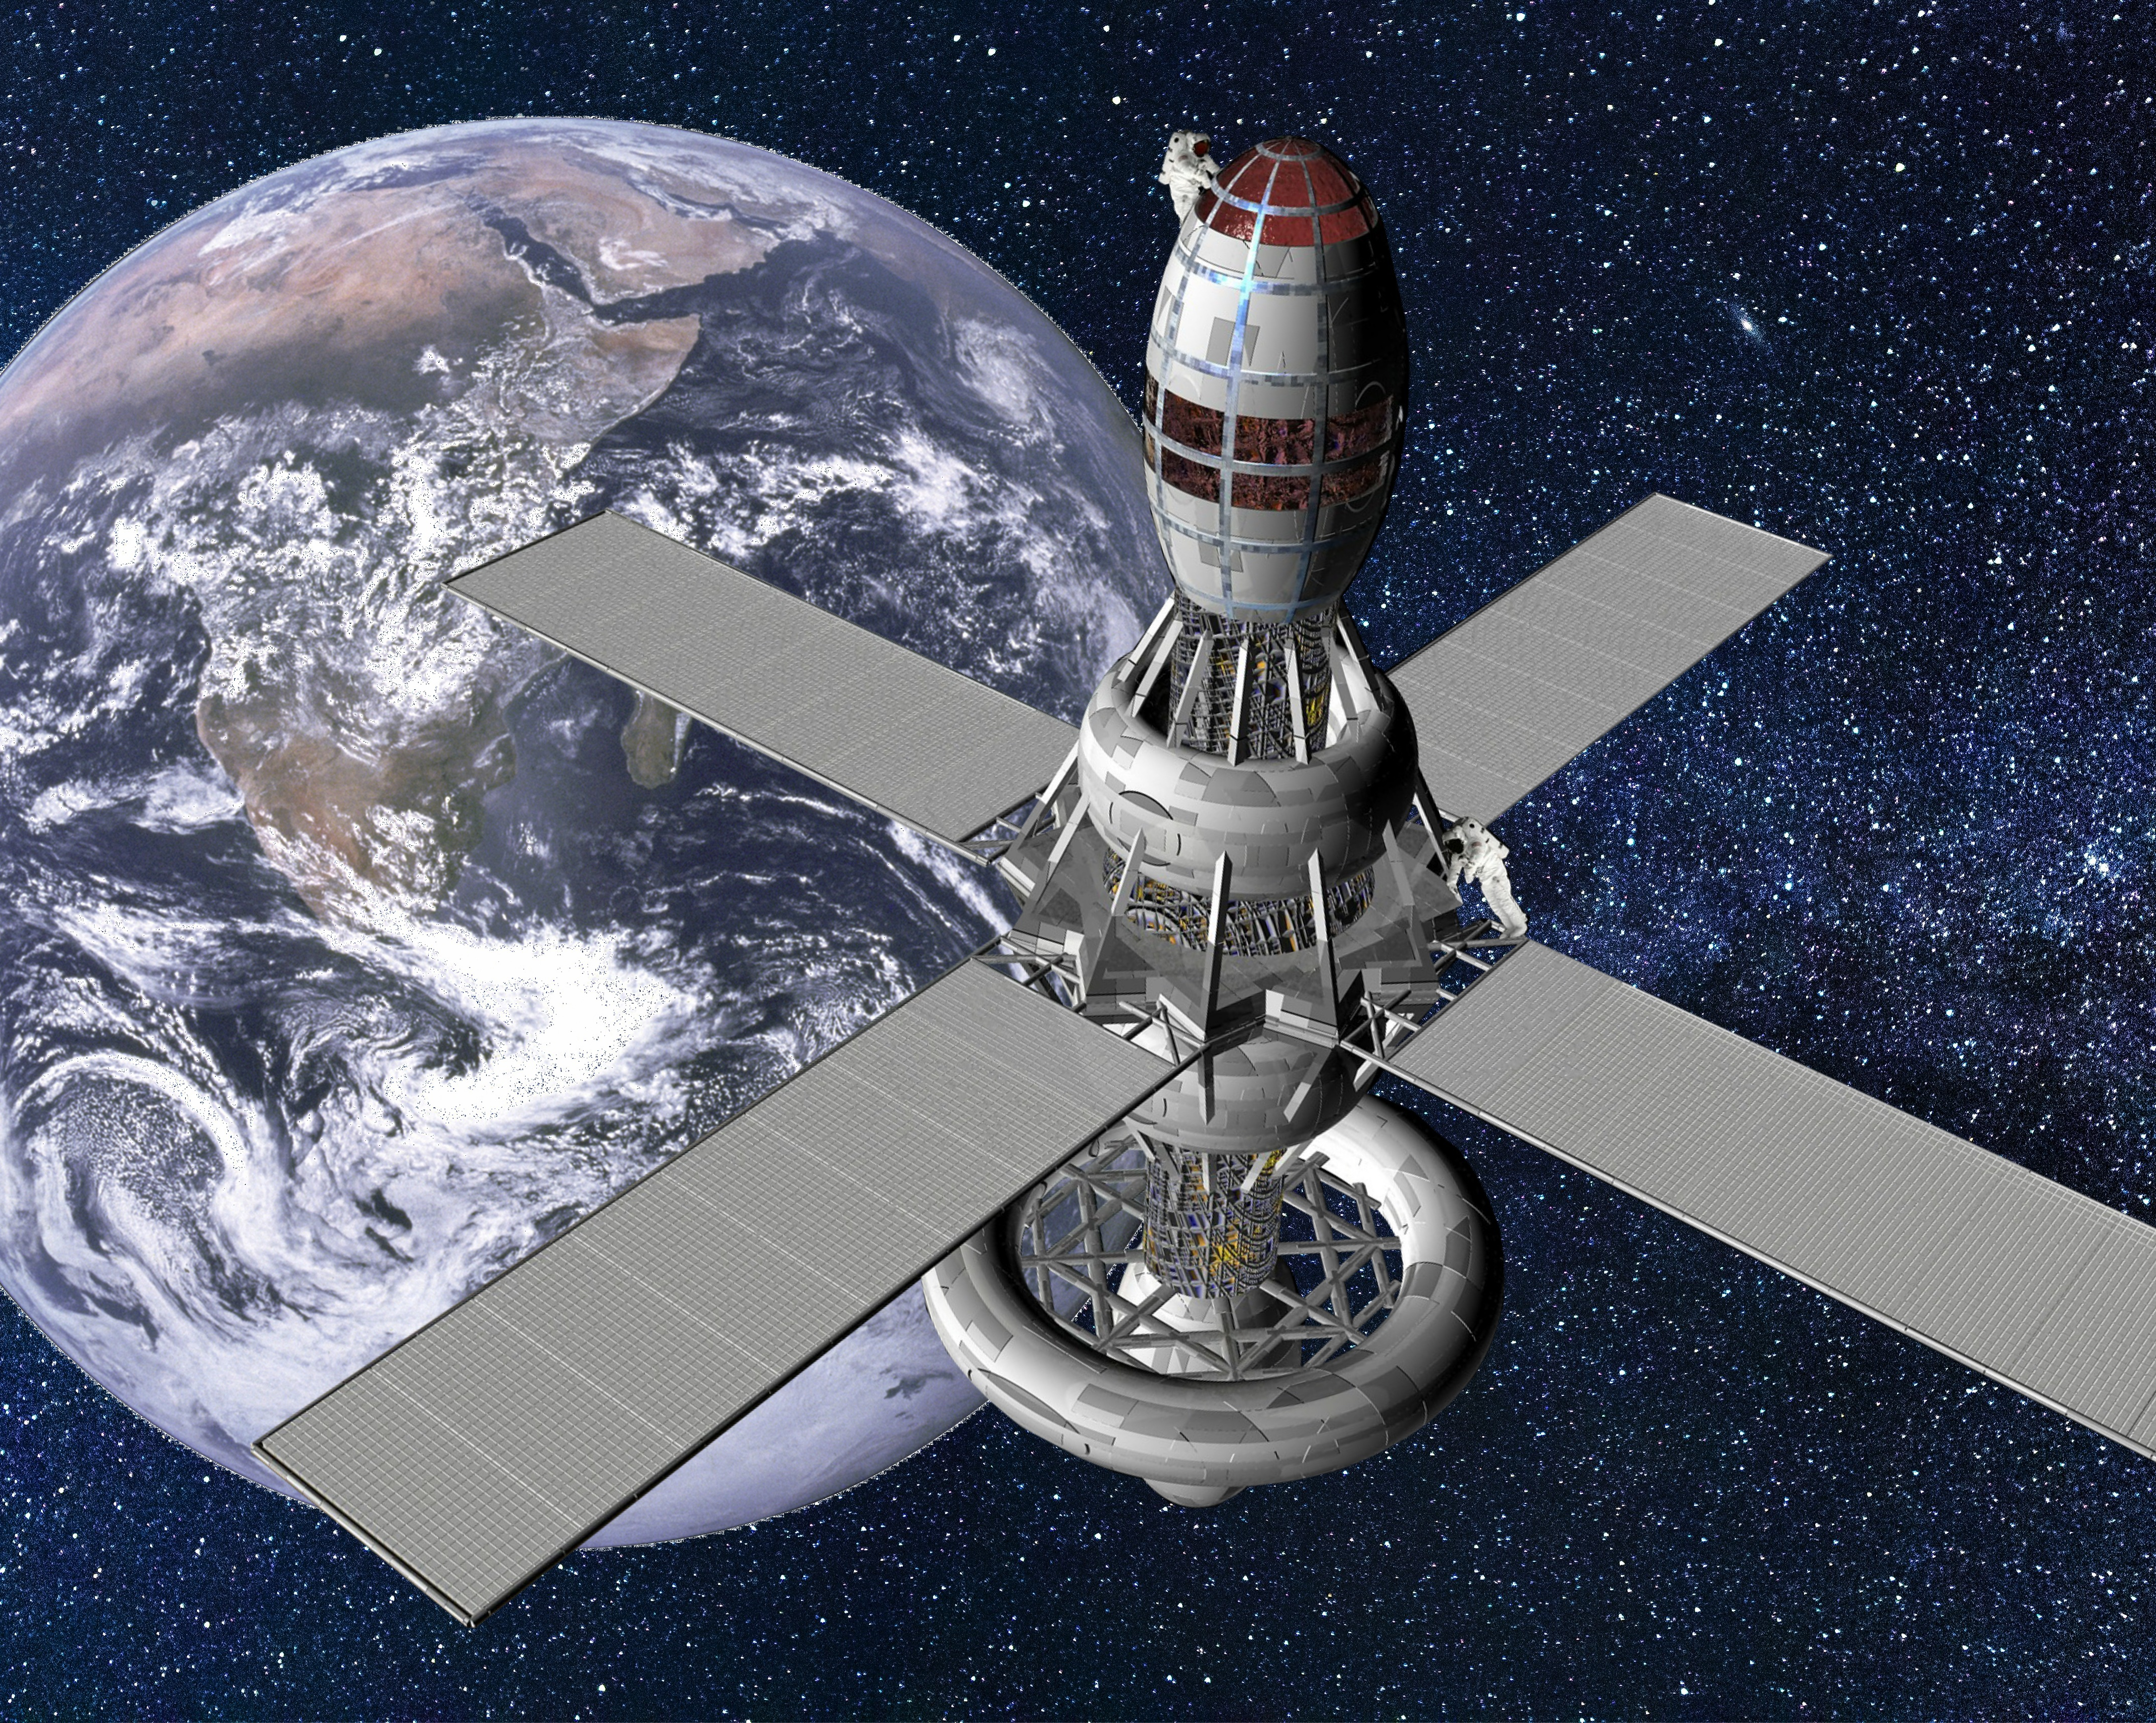
02
Strategic Alignment & National Labs
Multi-Agency Strategic Alignment Matrix
National Transformation Model
NEOL
NGSL
NAOL

Slide 15
Comprehensive Multi-Agency Strategic Alignment Matrix
To unlock national funding channels, avoid wasteful asset duplication, and firmly secure institutional buy-in, IESS goals must align precisely with the mandates of key civil, military, and regulatory stakeholders.
Stakeholder / Agency
Core Priority/Need Aligned with IESS
Specific Interoperability & Strategic Action Mechanisms
Saudi Vision 2030
Non-oil GDP diversification; expansion of local content; fostering of tech-driven startups
Map downstream services into high-margin commercial data APIs; build incubator pipelines for domestic Space-Tech spin-offs
Research, Development, & Innovation Authority (RDIA)
National RDI Mission Charters (Sustainability, Economies of the Future)
Execute Wave 1 space missions under institutional co-funding frameworks; secure programmatic grants for applied technological developments
Ministry of Environment, Water and Agriculture (MEWA) & Environmental Centers
National Environment Strategy execution; climate forecasting, wildlife tracking, automated pollution tracing, and landfill tracking
Ingest multi-sensor arrays (SAR, InSAR, Hyperspectral) into automated pipelines to audit the Saudi Green Initiative, monitor aquifers, trace spills, and map weather events
Saudi Space Agency (SAA)
Operational execution of the National Space Strategy; deep-space exploration and lunar/Mars positioning
Act as the primary technical execution arm for upstream satellite assembly, integration, and testing (AIT), alongside uncrewed rover research
Saudi Geological Survey (SGS)
National mineral mapping, asset exploration, and sustainable mine safety
Supply systematic Synthetic Aperture Radar (SAR) and Interferometric SAR (InSAR) surface deformation models for structural stability assessments
Saudi Geological Survey (SGS)
National mineral mapping, asset exploration, and sustainable mine safety
Supply systematic Synthetic Aperture Radar (SAR) and Interferometric SAR (InSAR) surface deformation models for structural stability assessments

Slide 16
Comprehensive Multi-Agency Strategic Alignment Matrix
To unlock national funding channels, avoid wasteful asset duplication, and firmly secure institutional buy-in, IESS goals must align precisely with the mandates of key civil, military, and regulatory stakeholders.
Stakeholder / Agency
Core Priority/Need Aligned with IESS
Specific Interoperability & Strategic Action Mechanisms
General Authority for Survey & Geospatial Information (GEOSA)
National governance of spatial data, reference stations, and geodetic positioning
Provide GEOSA with hyper-precise ground acquisition baselines and serve as an automated processing node for the national spatial data infrastructure
Ministry of Municipalities & Housing (MOMAH)
Smart city expansion, urban landscape upgrades, and real-time municipal planning
Deliver continuous urban vegetation mapping and predictive AI heat-island modeling to lower city surface temperatures
Ministry of Defense (MoD) & General Authority for Military Industries (GAMI)
Military-grade spatial reconnaissance, localized defense supply chains, and secure communications
Co-develop autonomous dual-use Earth Observation (EO) sensors and deploy encrypted Low Earth Orbit (LEO) satellite communication constellations
Communications, Space & Technology Commission (CST)
Telecommunications regulation, satellite licensing, spectrum oversight, and NTN architectures
Run validation testbeds for emerging Terrestrial and Non-Terrestrial Network (TN/NTN) communication protocols
Ministry of Energy (MoE)
Infrastructure protection, pipeline failure detection, and renewable energy integration
Provide autonomous, automated thermal and short-wave infrared (SWIR) satellite surveillance across the Kingdom's vast energy transmission networks
Universities & National Research Centers
Academic development, specialized research talent pipelines, and scientific publication output
Maintain open, low-cost distributed regional networks of radio telescopes to power collaborative planetary science and aerospace engineering programs

Slide 17

Core Pillar Strategy: Transitioning to Specialized National Laboratories
IESS will structure its capabilities into three distinct, impact-focused National Laboratories powered by Artificial Intelligence (AI) and emerging technologies.
The three national laboratories—NEOL, NGSL, and NAOL—will transition from traditional cost centers into revenue‑generating national assets. In alignment with KACST's mandate to maximize the value of laboratories and infrastructure, the Institute will adopt a commercial operating model built on paid operations, subscription‑based access to geospatial platforms, specialized consulting services, and long‑term government service contracts. This shift positions the laboratories as strategic economic engines supporting national sovereignty and the emerging space‑data economy.

Slide 18



IESS NATIONAL LABORATORIES
NEOL
NGSL
NAOL
Earth Observation Lab
Geospatial Solutions Lab
Astronomical Observatory Lab
AI-Driven & Emerging Technology Infrastructure
Core Application Domains & Product Suites
Specialized Training, Consultations, and Academic Acceleration
Advanced Processing & Emerging Tech Infrastructure
Core Operational Portfolios & Product Suites
Specialized Training, Consultations, and Ecosystem Development
AI-Driven Analytics & Advanced Observational Infrastructure
Core Operational Pillars & Product Portfolios
Training, Consultations, and Strategic Advisory

Slide 19

Pillar 1:
The National Earth Observation Laboratory (NEOL)
PILLAR 1
PILLAR 2
A strategic framework transitioning IESS from a traditional research model to an impact-driven, revenue-generating architecture powered by Artificial Intelligence and emerging technologies.
PILLAR 3

Slide 20
The National Earth Observation Laboratory (NEOL)
Building on the strategic transition from a traditional research model to an impact-driven architecture, the National Earth Observation Laboratory (NEOL) will be structured to serve as a premier autonomous intelligence and predictive analytics hub.
By embedding artificial intelligence, computer vision, and big data architectures directly into the satellite data lifecycle, NEOL will convert raw imagery into high-margin, actionable downstream products, specialized training modules, and strategic consultations for national beneficiaries.
PILLAR 1
Strategic Imperative
AI-Driven & Emerging Tech Capabilities
Monetization & Products
PILLAR 2
Transition from passive data gathering to an active, predictive analytics ecosystem that services defense, environmental, and infrastructure stakeholders.
Imagery API — Commercialize the institute's unique, continuous 40-year satellite archive via a subscription API tailored for urban development historical analyses and legal property boundary assessments.
Early Awareness System — Sell real-time anomaly detection pipelines to civil defense and municipal authorities for early detection of flash floods, active sandstorms, structural pipeline compromises, or industrial carbon emission spikes.
Deploy deep learning architectures (Convolutional Neural Networks and Vision Transformers) directly onto multi-modal sensor streams. Melt distinct tracking capabilities, fusing Electro-Optical (EO), Infrared (IR), Hyperspectral, and Synthetic Aperture Radar (SAR), into unified, real-time tracking pipelines.
PILLAR 3

Slide 21
1
AI-Driven & Emerging Technology Infrastructure
To move past manual image analysis, NEOL will deploy an integrated, cloud-native computational pipeline capable of processing massive volumes of multi-modal data automatically.
PILLAR 1
PILLAR 2
Computer Vision & Deep Learning Foundation
Multi-Modal Data Fusion
Automated InSAR & Deformation Stacks
Fusing disparate sensor streams—combining high-resolution Electro-Optical (EO) crispness, Thermal/Infrared (IR) signatures, Hyperspectral chemical footprints, and day/night Synthetic Aperture Radar (SAR) waveforms—into a single, consolidated operational dashboard.
Utilizing deep neural networks (such as custom-trained Vision Transformers and convolutional architectures) to execute automated object detection, multi-class semantic segmentation, and instant feature extraction at scale.
Deploying continuous, automated Interferometric SAR (InSAR) processing loops to solve for millimeter-level surface displacement and vertical land deformation across the entire geography of the Kingdom without human intervention.
PILLAR 3

Slide 22
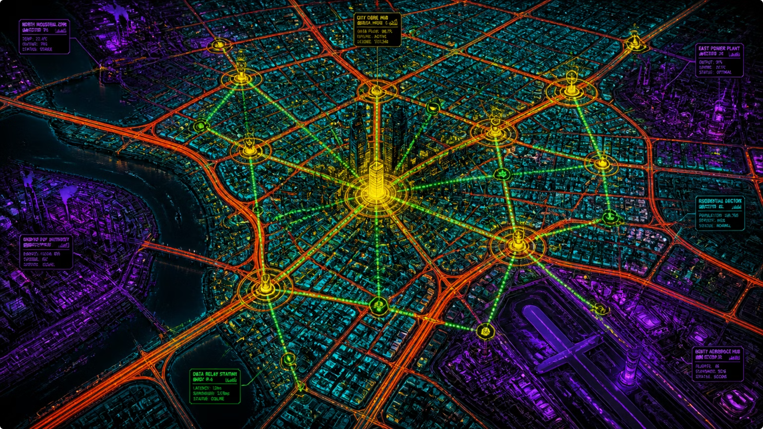
2. Core Application Domains & Product Suites
2
Core Application Domains & Product Suites
NEOL will align its technical outputs with distinct commercial product suites to satisfy the operational needs of national civil, defense, and industrial partners.
PILLAR 1
A. National Security & Tactical Reconnaissance
PILLAR 2
Independent Border Surveillance — Autonomous computer vision pipelines trained to run anomaly and change detection across strategic land borders and maritime corridors, automatically flagging un-flagged structural assets or vehicles.
Strategic Foreign Asset Monitoring — Supplying localized intelligence agencies with custom, high-accuracy tasking capabilities to observe and map global developments relevant to Saudi Arabia's defense interests.
Military Mobility Maps — Fusing optical and SAR datasets to deliver dynamic terrain trafficability mapping, soil moisture composition metrics, and precise tactical navigation base-layers.
PILLAR 3

Slide 23
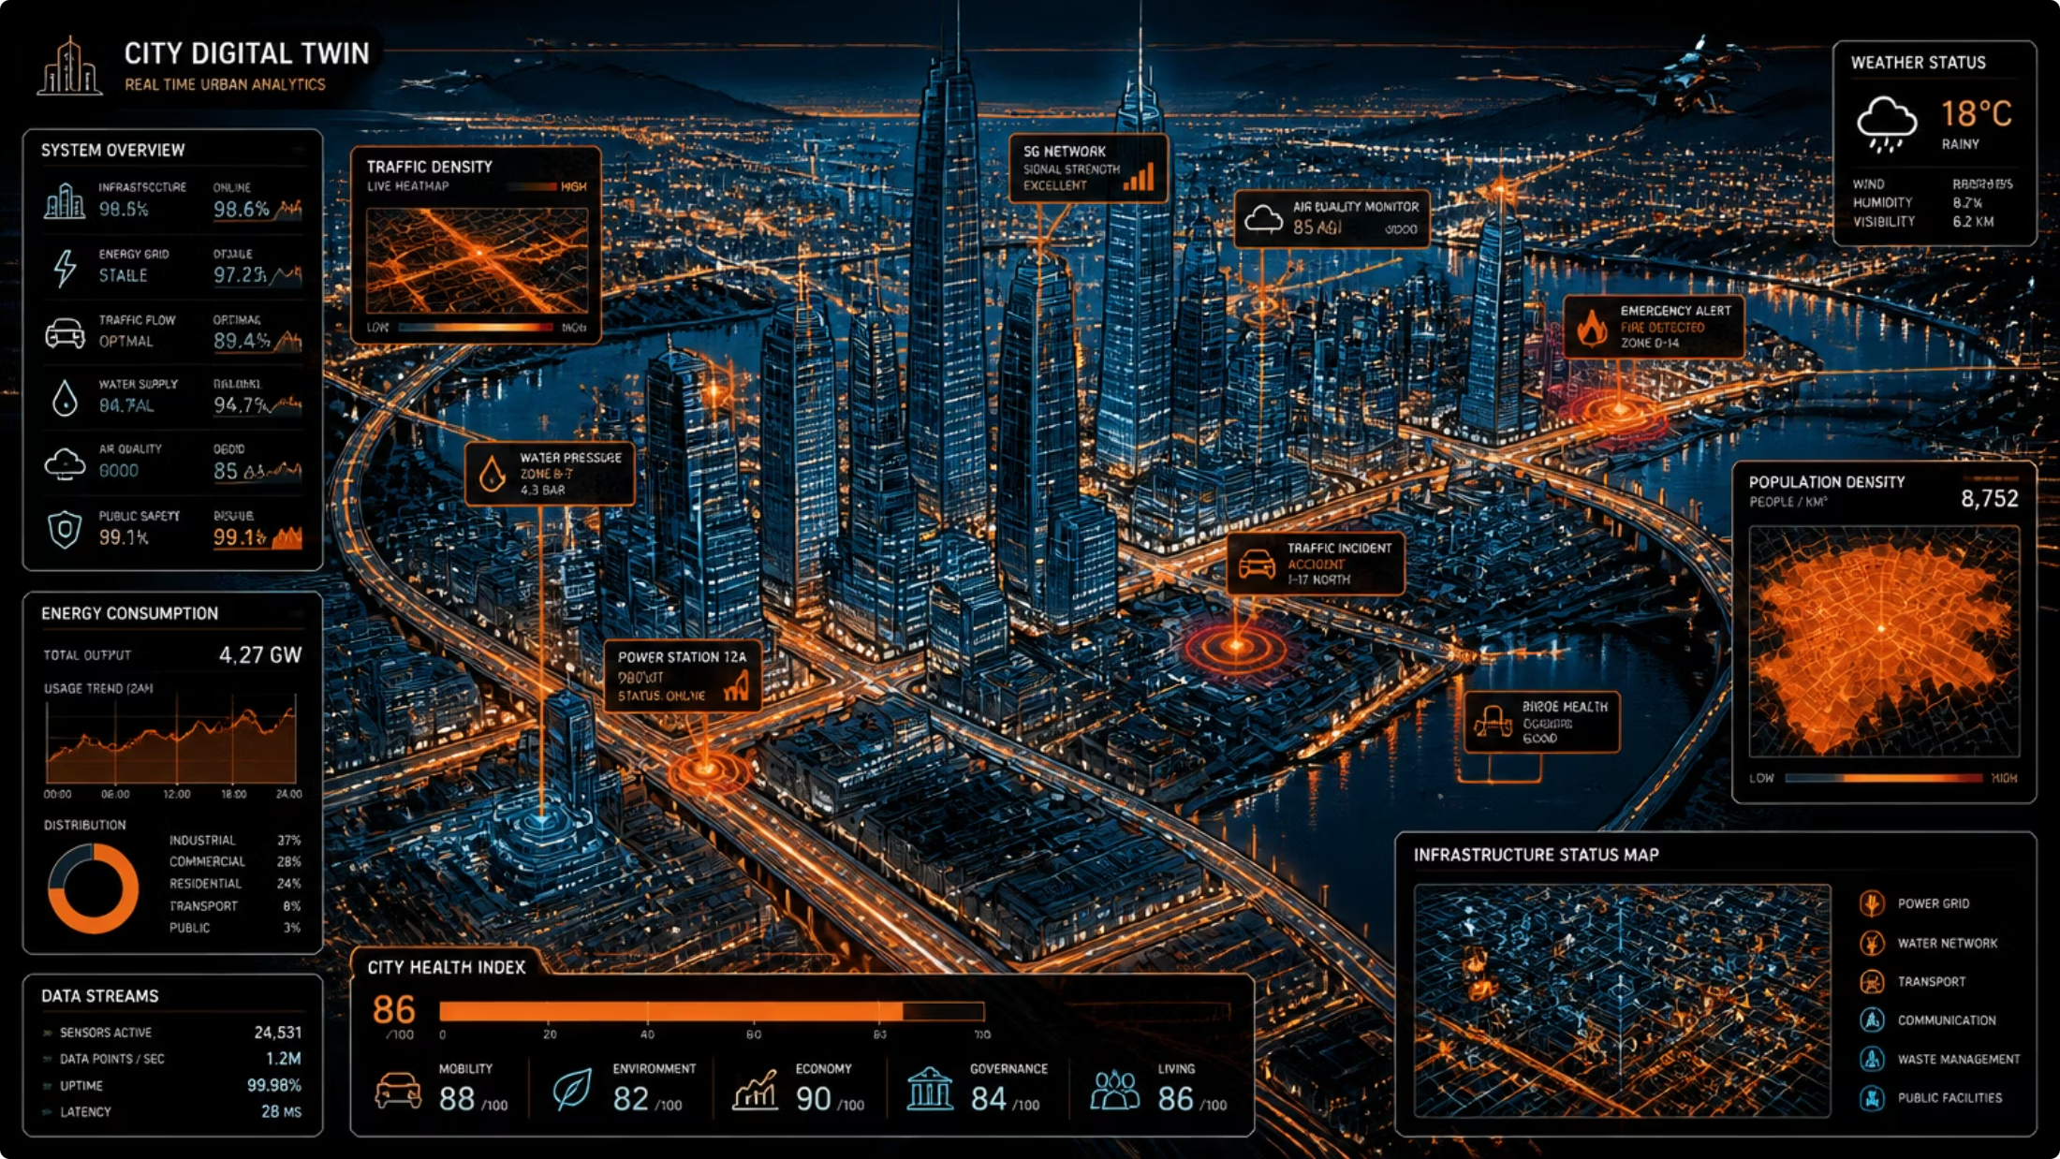
2. Core Application Domains & Product Suites
B. Smart Cities & Urban Twins
Dynamic Urban Landscape Tracking — Delivering continuous, automated spatial data directly to entities like MOMAH and NEOM to monitor physical construction velocities, structural vertical alignment, and zoning compliance.
Predictive Urban Heat-Island Modeling — Leveraging thermal infrared sensor channels to generate surface temperature trends, allowing municipal planners to optimize green infrastructure layouts and achieve the target of reducing summer surface temperatures by 4°C.
Infrastructure Health Alerts — Automated alerts for critical national infrastructure via InSAR, identifying subtle pavement cracking, structural bridge shifting, or airport runway sinking before failure occurs.
PILLAR 1
PILLAR 2
PILLAR 3

Slide 24
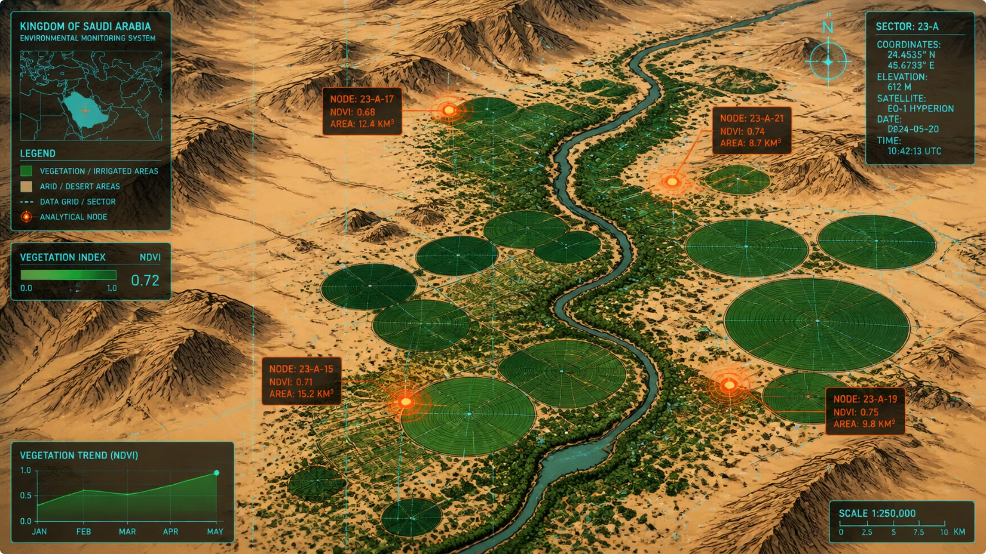
2. Core Application Domains & Product Suites
C. Environmental Monitoring & Climate Sustainability
PILLAR 1
The Saudi Green Initiative Engine — Serving as the definitive auditing node for the "Plant 10Bn Trees by 2040" mission by utilizing hyperspectral data to verify precise plant counts, evaluate crop health parameters, and measure localized carbon sequestration densities.
Early Warning Disaster Infrastructure — Deploying proactive predictive models to mitigate risks from flash flooding, dynamic sandstorm propagation, and active wildfire spread, feeding directly into local early warning systems.
Aquifer & Marine Ecosystem Auditing — Monitoring surface deformation variables to evaluate groundwater extraction impacts and sustainable aquifer capacity, alongside tracking coastal oil spills and coral reef health.
PILLAR 2
PILLAR 3

Slide 25
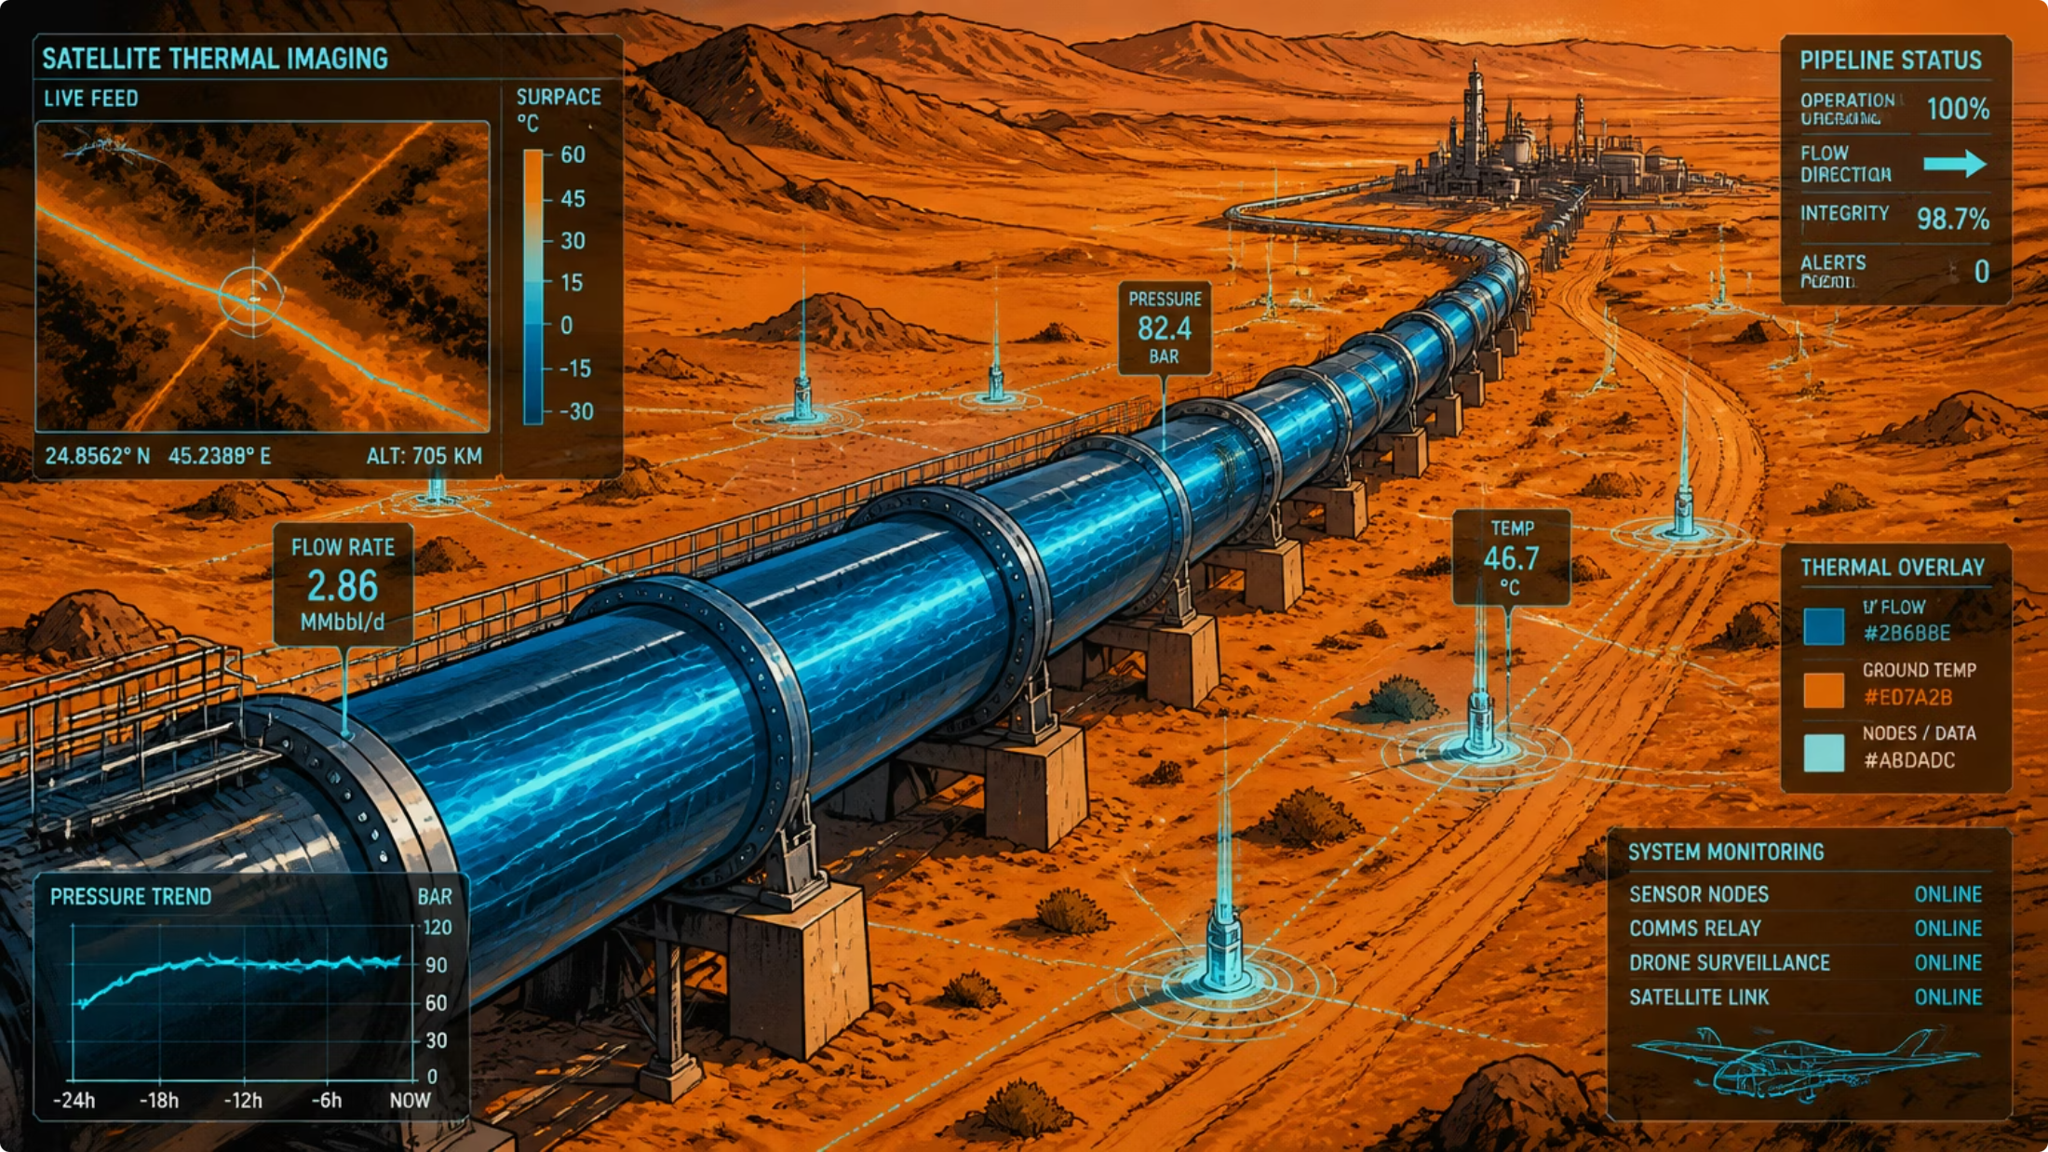
2. Core Application Domains & Product Suites
D. Energy & Mining Logistics
Pipeline Integrity Monitoring — Drone and micro-satellite sensor loops scanning vast oil and gas transport segments to catch un-mapped leakages, structural ground shifts, or vegetation encroachment risks.
Automated Mineral Exploration Support — Producing hyperspectral background imagery and geological baseline vectors to map mineral surface expressions and optimize mineral extraction programs.
PILLAR 1
PILLAR 2
PILLAR 3

Slide 26
3
Specialized Training, Consultations & Academic Acceleration
To cultivate a sustainable local space sector ecosystem, NEOL will operate a dedicated, revenue-generating knowledge transfer and advisory division.
PILLAR 1
A. Professional Training & Certification Programs
B. Strategic Consulting and Advisory Services
C. Academic Co-Innovation Hubs
Distributed Open-Data Repositories — Launching a secure sandbox environment that provides national universities with access to indexed, clean satellite data subsets, accelerating the publication of peer-reviewed scientific studies and national patents.
Joint PhD and Post-Doc Fellowships — Sponsoring applied research theses centered on cutting-edge space problems to systematically build the domestic research cadre.
Applied Space-Data Engineering Academy — Offering multi-tiered professional certificates for remote sensing analysts, focusing on cloud architecture execution, scalable geospatial data engineering, and machine learning deployment.
AI-Driven Remote Sensing Bootcamps — Direct training tracks tailored for data scientists within external ministries (e.g., Ministry of Defense, Ministry of Energy) to build custom domain-specific segmentation models.
Feasibility Studies and Mission Architecture Design — Acting as the primary state technical consultant to evaluate sensor payloads, orbital configurations, and downstream pipelines for any independent entity or private enterprise deploying space assets.
National Standards Governance — Collaborating with regulatory bodies to define and maintain unified national metadata standards, precision criteria, and security classification levels for all earth observation activities.
PILLAR 2
PILLAR 3

Slide 27

NEOL: A Strategic Economic Engine
NEOL positions IESS as a sovereign capability and revenue-generating national asset—transforming satellite data into actionable intelligence for defense, environment, smart cities, and energy stakeholders across the Kingdom.
Predictive Analytics Hub
AI-embedded satellite data lifecycle converting raw imagery into high-margin downstream products.
Multi-Agency Alignment
Strategic interoperability with 11 national stakeholders across civil, military, and regulatory domains.
Commercial Operating Model
Paid operations, subscription APIs, specialized consulting, and long-term government service contracts.
Knowledge Economy
Professional certification, strategic advisory, and academic co-innovation to build the domestic research cadre.

Slide 28

Pillar 2:
The National Geospatial Solutions Laboratory (NGSL)
PILLAR 1
PILLAR 2
To complement the transformation of our Earth Observation capabilities, the National Geospatial Solutions Laboratory (NGSL) will serve as the engine room for the Kingdom's spatial data infrastructure. The primary focus of this national laboratory is to transition the institute from flat, static mapping into a provider of dynamic, multi-dimensional geospatial intelligence.
By modernizing our 40-year heritage in GIS, geodesy, and high-precision positioning, NGSL will leverage artificial intelligence, edge computing, and advanced spatial modeling to deliver premium downstream products, corporate certifications, and strategic spatial consultations.
PILLAR 3

Slide 29
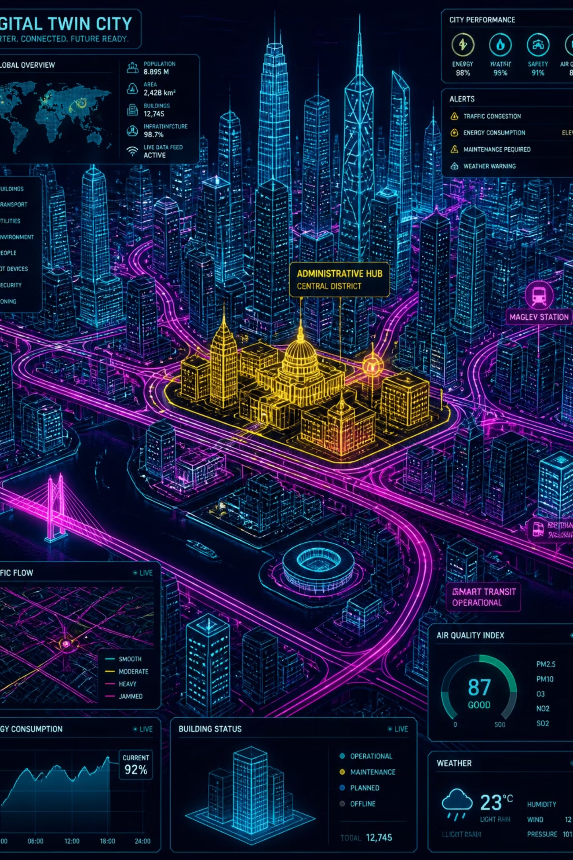
Strategic Imperative & AI-Driven Capabilities
Strategic Imperative
PILLAR 1
Serve as the prime national repository and intelligence processing engine for geodetic reference networks and spatial lifecycle management.
AI-Driven & Emerging Tech Capabilities
PILLAR 2
Utilize point-cloud segmentation models, automated edge computing, and neural rendering to process high-precision ground acquisitions and automated drone surveys into dynamic models.
PILLAR 3
Monetization & Products
Dynamic Kingdom Digital Twins
Mobility Base-Layers

Slide 30
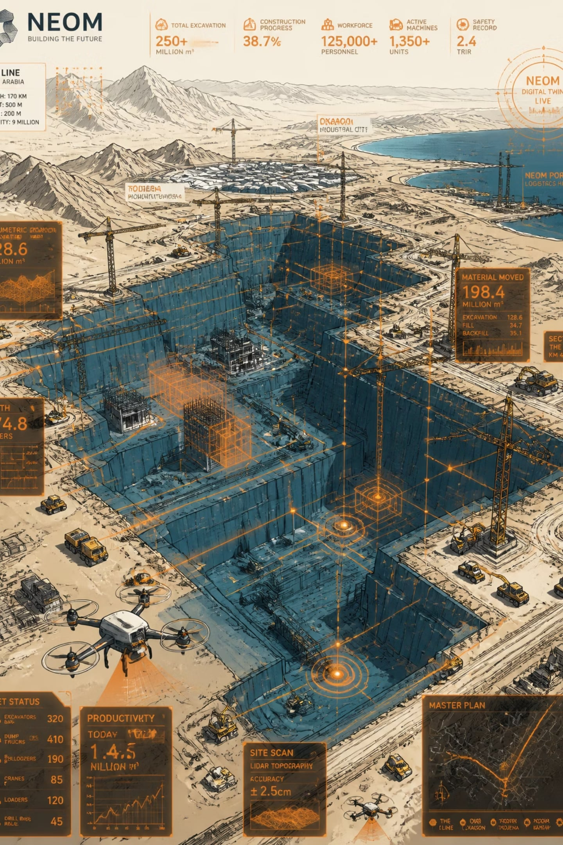
Monetization & Products
Dynamic Kingdom Digital Twins
PILLAR 1
Provide continuous, high-resolution 3D geospatial vectors to builders of mega-projects (such as NEOM and Red Sea) to monitor physical development speeds, volumetric land excavations, and precise structural settling parameters.
PILLAR 2
Mobility Base-Layers
PILLAR 3
Generate high-definition (HD) localization mapping layouts to support next-generation commercial autonomous vehicle fleets, logistics routing systems, and delivery drone paths across urban centers.

Slide 31
1
Advanced Processing & Emerging Tech Infrastructure
To meet the complex tracking needs of massive regional developments, NGSL's computing environment will focus on automating data extraction, lifecycle orchestration, and spatial geometry modeling.
PILLAR 1
AI-Driven Automated Feature Extraction
Real-Time Spatial Data Streams & IoT Integration
Next-Generation Cloud Geodesy
PILLAR 2
Deploying neural networks trained on top-grade topographic imagery to automatically discover, classify, and extract geometric features (such as roads, structural building footprints, transmission lines, and water channels). This removes months of manual vector editing and accelerates map production cycles.
Building high-throughput cloud ingestion loops to process active spatial telemetry from Internet of Things (IoT) sensors, mobile networks, and connected transport fleets.
Utilizing advanced mathematical modeling and physics algorithms to automate the continuous adjustment of national coordinate reference frames, calculating precise tectonic shifts and structural baseline variations across the Arabian plate.
PILLAR 3

Slide 32
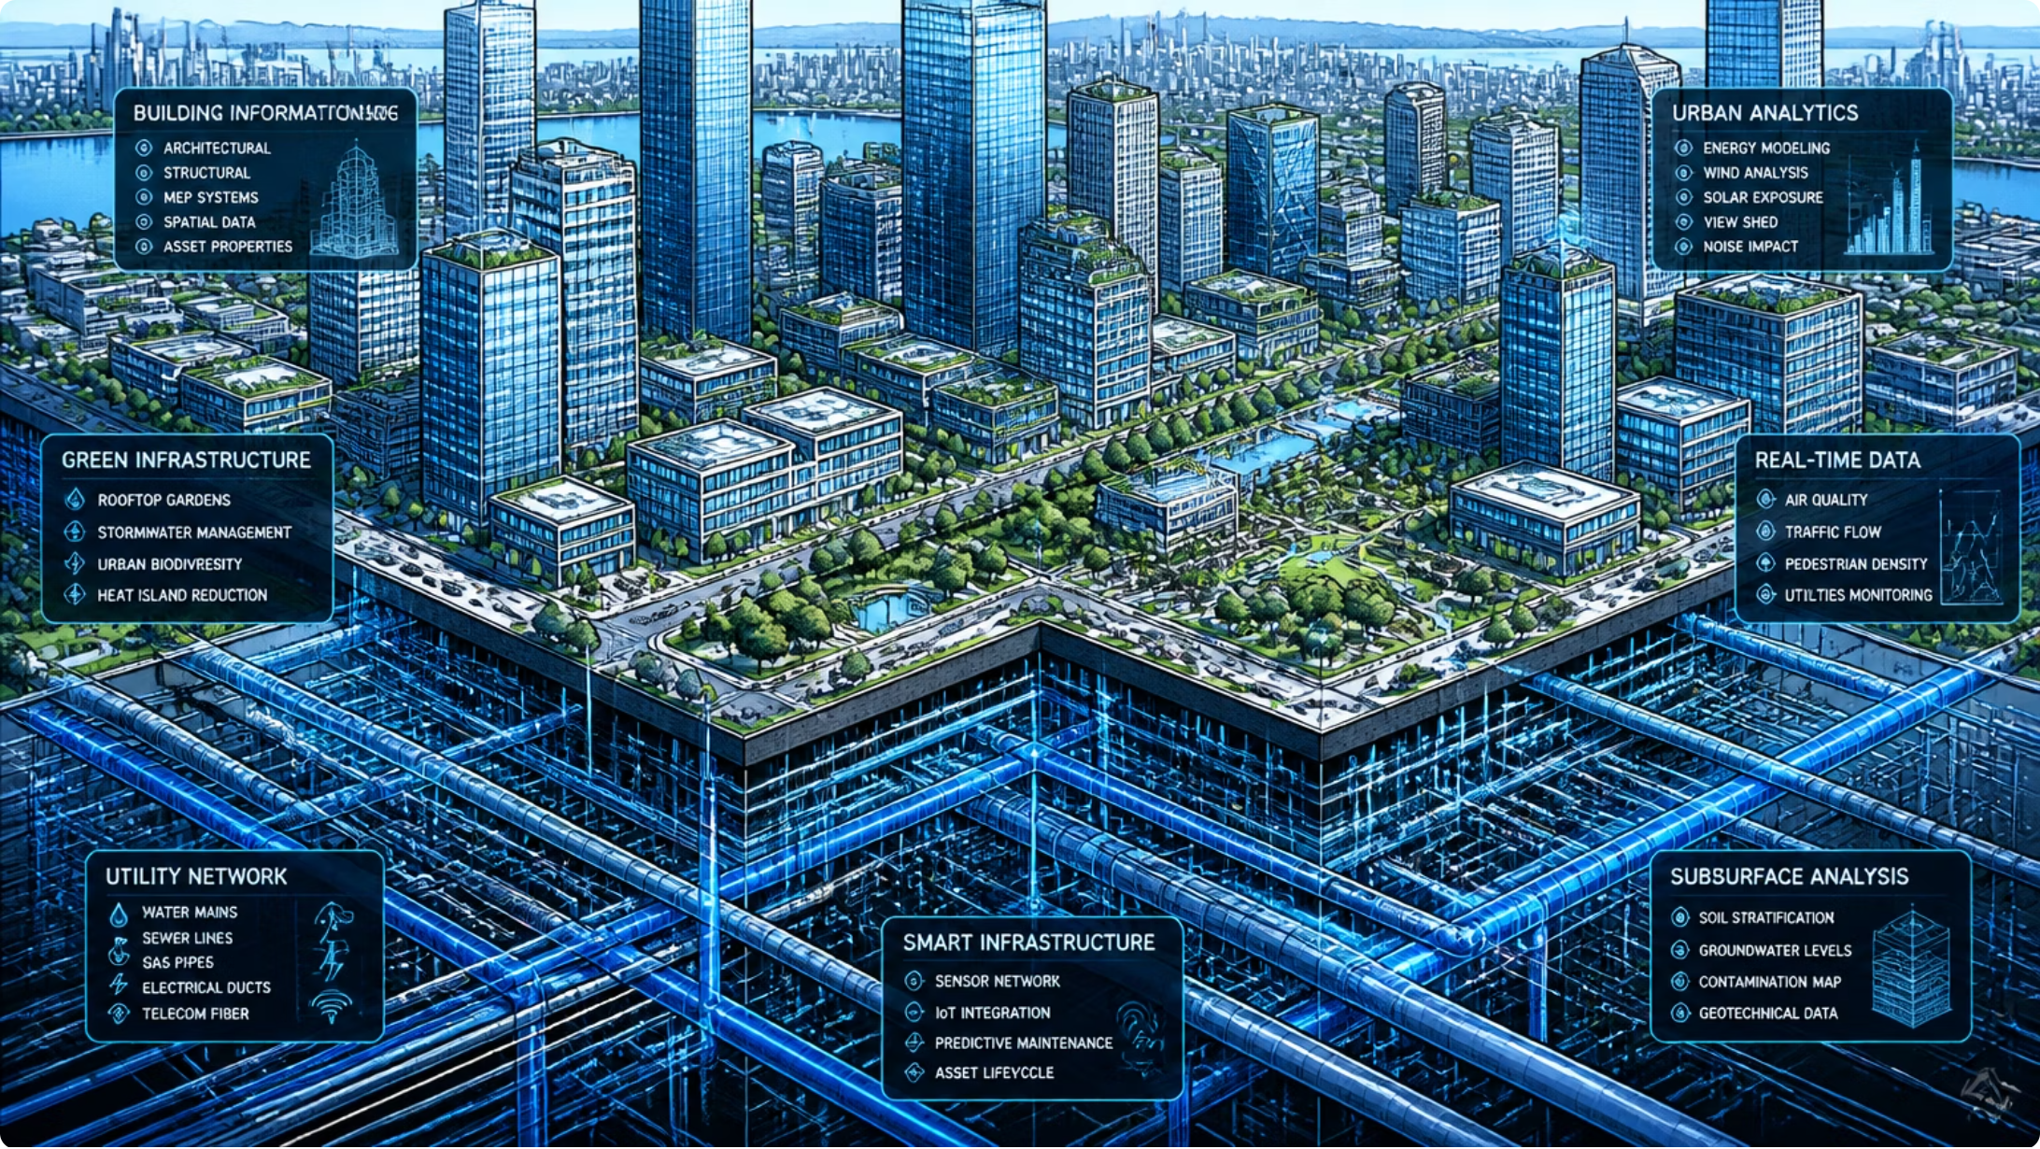
2. Core Operational Portfolios & Product Suites
2
Core Operational Portfolios & Product Suites
NGSL will structure its technical capabilities into high-demand commercial product lines targeting distinct state and commercial target industries.
A. Dynamic City Digital Twins (3D&4D GIS)
PILLAR 1
Volumetric Development Auditing
Building spatial models that integrate traditional GIS with building information data (BIM) to track ongoing macro-construction progress, land excavation volumes, and raw material logistics.
PILLAR 2
PILLAR 3
Subsurface Infrastructure Mapping
Creating secure 3D spatial registries mapping underground utilities, transport networks, and municipal pipelines to prevent collision risks during rapid infrastructure expansions.

Slide 33

2. Core Operational Portfolios & Product Suites
B. Autonomous Transport & Mobility Base-Layers
PILLAR 1
High-Definition (HD) Mapping Baselines
Supplying sub-decimeter accurate road geometry, lane-boundary vectors, and intersection layouts to empower autonomous automotive vehicles and intelligent transport systems.
PILLAR 2
PILLAR 3
Micro-Mobility and Drone Airspace Routing
Designing low-altitude 3D corridors and dynamic spatial obstacles grids to govern urban cargo drone delivery networks safely.

Slide 34
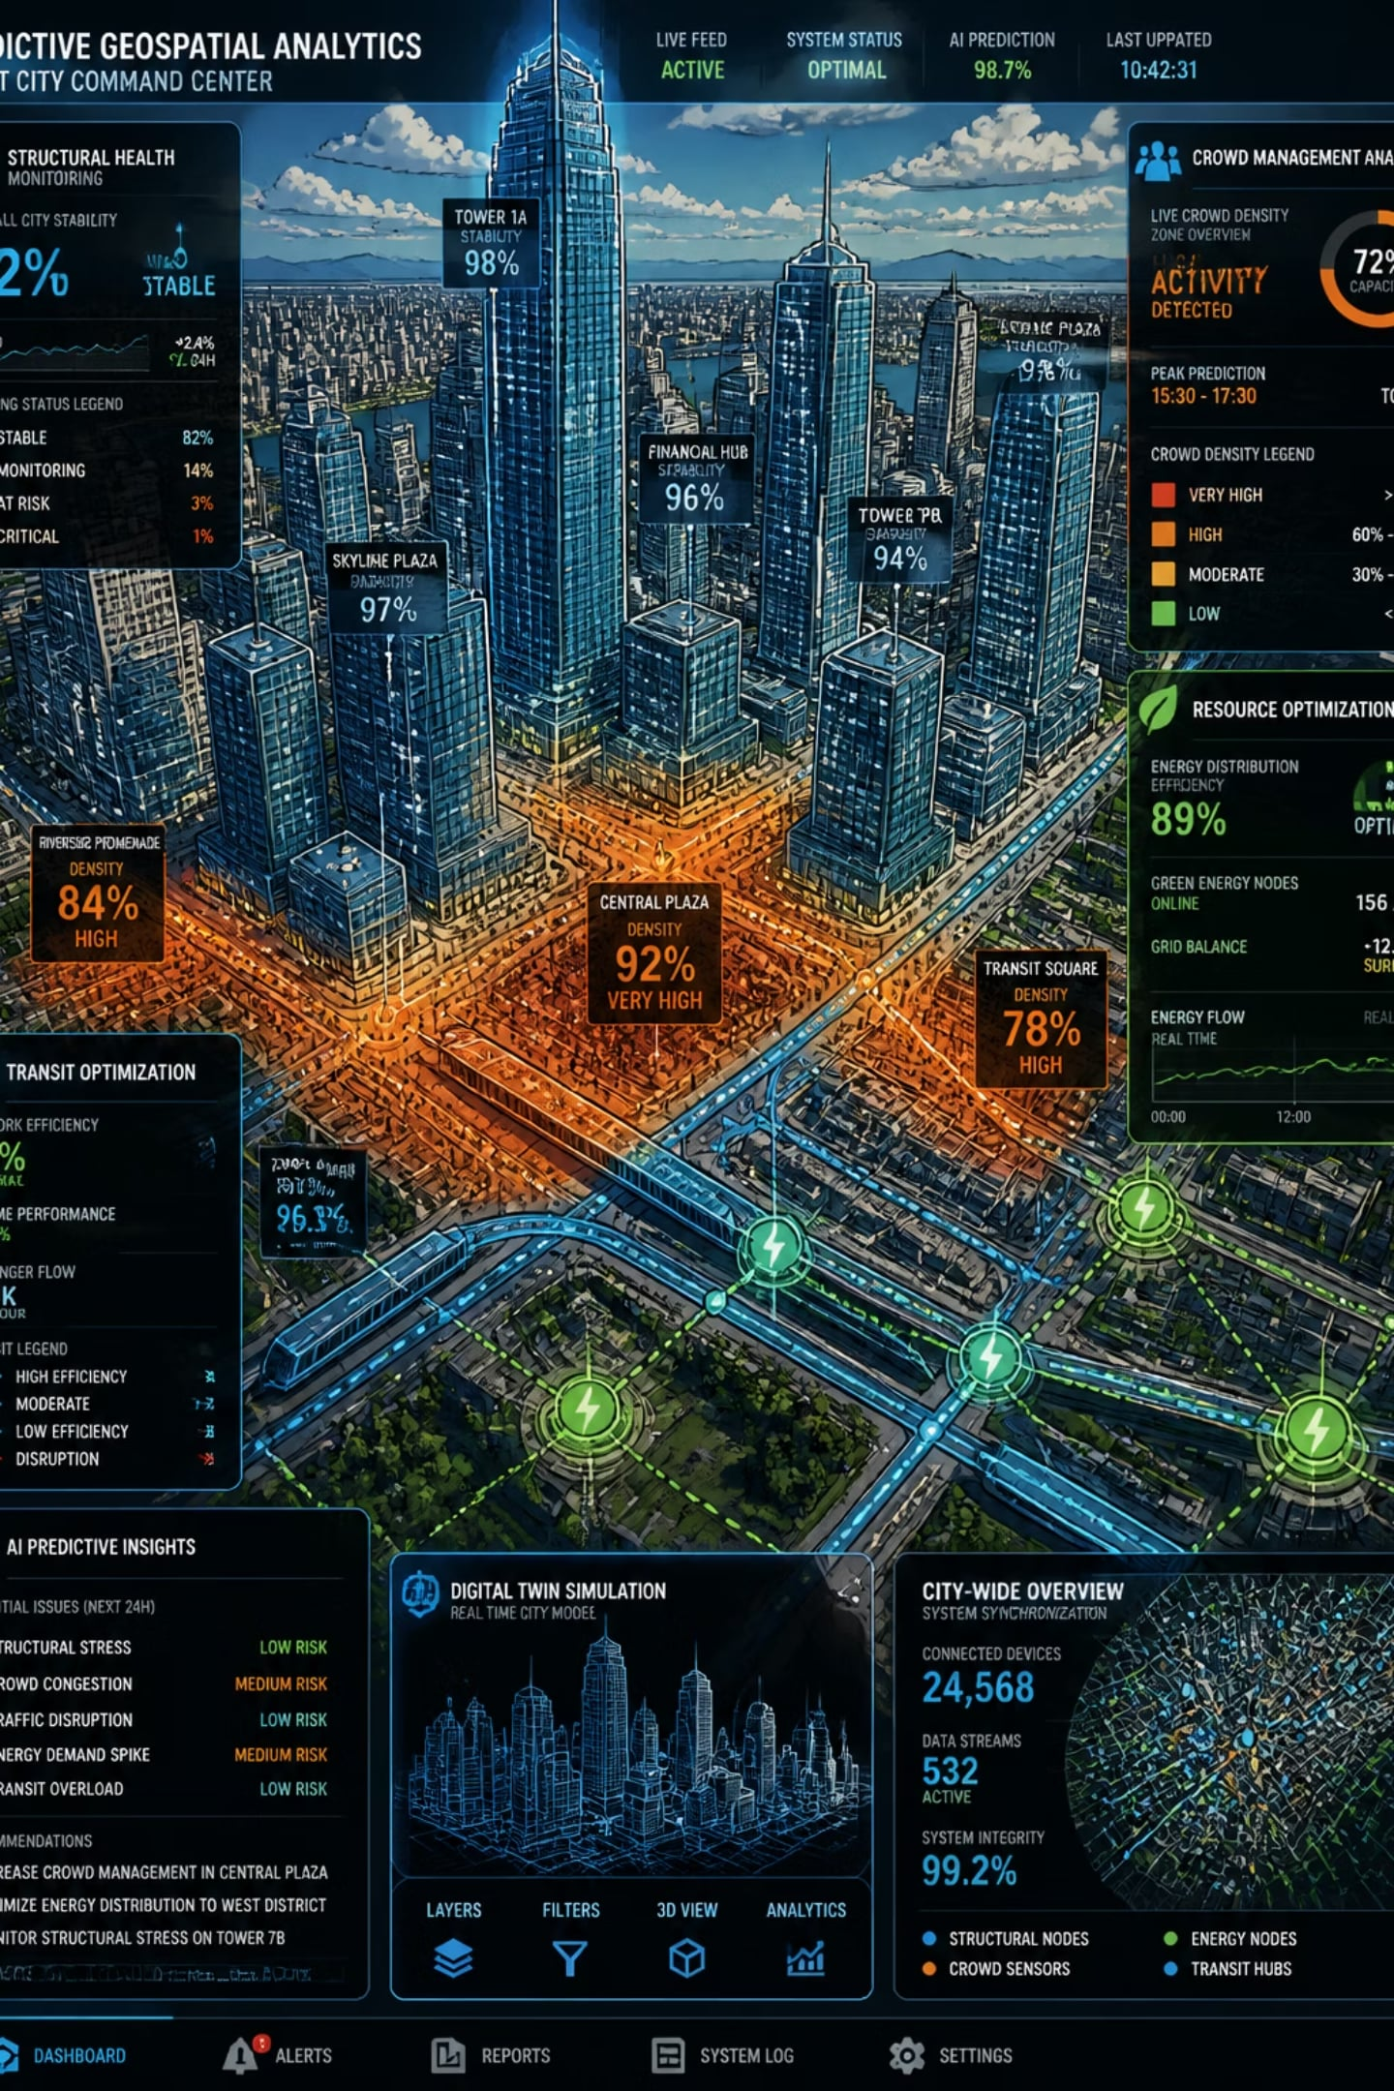
2. Core Operational Portfolios & Product Suites
C. Predictive Location Analytics & Strategic Insights
Structural Health and Subsidence Alerts
PILLAR 1
Generating predictive geospatial risk maps identifying slow structural settling, bridge leaning, or terrain instability near high-value economic corridors.
PILLAR 2
Intelligent Crowd Management Systems
Applying geospatial spatial-temporal modeling to predict traffic congestion points and coordinate crowd movements safely within smart city zones.
PILLAR 3
Resource Optimization Infrastructure
Providing agricultural geospatial intelligence, asset visibility maps, and energy logistics distribution networks to optimize the performance of national resource portfolios.

Slide 35
3
Specialized Training, Consultations, and Ecosystem Development
To drive complete national localization and support domestic space-tech startups, the laboratory will operate a commercial spatial engineering and certification business unit.
PILLAR 1
1
2
3
A. Professional Training & Certification Programs
B. Strategic Consulting and Spatial Advisory
C. Academic Acceleration & Startup Sandboxes
PILLAR 2
Spatial Data Scientist Academy
Offering structured, multi-tier professional credentials covering spatial database architecture, automated Python-based spatial processing, and machine learning analytics.
Smart City Spatial Integration Tracks
Specialized professional development training for municipal engineers and private defense contractors to implement advanced spatial data infrastructure standards.
National Spatial Infrastructure Advisory:
Acting as the prime technical advisor to design, calibrate, and evaluate large-scale spatial databases and geodetic reference networks for state and private enterprises.
Interoperability Standards Governance
Defining unified national geodatabase schemas and metadata criteria to guarantee fluid interoperability across national security and infrastructure stakeholders.
The Geodata Vault
Hosting an isolated, high-performance computing repository that exposes rich baseline geographic layers to national universities, fueling research in smart logistics, hydrology, and environmental geology.
Venture Incubation Pipelines
Providing early-stage space-tech and mapping startups with access to high-accuracy geodetic processing software platforms to catalyze new geospatial consumer services.
PILLAR 3

Slide 36

Pillar 3:
The National Astronomical Observatory Laboratory (NAOL)
PILLAR 1
PILLAR 2
To complete the strategic modernization of the institute, the National Astronomical Observatory Laboratory (NAOL) will be established to transform Saudi Arabia's astronomical capabilities from traditional sky observation into an advanced, data-driven space science engine.
By upgrading our historical observatory networks with artificial intelligence, automated sensor arrays, and edge-computing optics, NAOL will secure oversight of our regional sky sector, streamline civil calendar calculations, and build a high-revenue ecosystem for astrophotography, astro-tourism, and deep-space research.
PILLAR 3

Slide 37
Strategic Imperative & AI-Driven Capabilities
Strategic Imperative
AI-Driven & Emerging Tech Capabilities
PILLAR 1
Establish a state-of-the-art observation capability to secure regional sky-sector supremacy and drive high-impact planetary and space tourism revenues.
Apply automated computer vision algorithms to stellar sensor arrays for space situational tracking and coordinate real-time tracking arrays with automated multi-station telescopes.
Monetization & Products
PILLAR 2
Space Situational Awareness (SSA) Engine
Civil Calendar Validation Systems
Astro-Tourism & Stargazing Infrastructure
PILLAR 3
Provide defensive orbit tracking services to flag and avoid space debris collisions threatening valuable satellite assets
Serve as the absolute technical verification node for the Umm Al Qura calendar authority and national moon-sighting committees using high-altitude mid-day infrared crescent capture devices
Develop commercial dark-sky reserves and deep-space observatory installations in remote regions of western and northwestern Saudi Arabia, offering premium astro-educational platforms and tourist facilities

Slide 38
1
AI-Driven Analytics & Advanced Observational Infrastructure
To move beyond manual lens adjustments and localized data silos, NAOL will deploy a synchronized, software-defined network of robotic ground telescopes and space situational awareness (SSA) computing architectures.
PILLAR 1
AI-Automated Transient Detection & Classification
Robotic Autonomous Telescope Networks
Space Situational Awareness (SSA) Engine
PILLAR 2
Integrating machine learning computer vision models directly onto digital optical and radio telescope streams. These models will automatically identify, track, and categorize fast-moving astronomical events, such as near-Earth asteroids, supernovae, and orbital space debris, without requiring continuous human tracking.
Upgrading scattered regional observatories into an interconnected, self-orchestrating matrix. When an anomaly is discovered by one sensor, the centralized AI routing loop will automatically task adjacent telescopes to adjust their focus and lock onto the coordinates instantly.
Deploying high-precision optical and radio wave tracking pipelines to map, monitor, and predict the trajectories of foreign satellites and orbital clutter passing through the Kingdom's airspace, directly supporting national asset protection.
PILLAR 3

Slide 39

2. CORE OPERATIONAL PILLARS & PRODUCT PORTFOLIOS
2
Core Operational Pillars & Product Portfolios
NAOL will segment its technical operations into commercial and civic product lines designed to service government, industrial, and public stakeholders.
A. Civic Calendar Verification & Islamic Astronomy
PILLAR 1
Automated Lunar Month Verification APIs
Partnering directly with the Umm Al Qura calendar authority and national moon-sighting committees. NAOL will utilize unique, high-altitude mid-day infrared and crescent telescope setups to automatically capture, enhance, and digitally verify the birth of the lunar crescent through a secure, auditable data stream.
PILLAR 2
PILLAR 3
Precision Astronomic Reference Datasets
Serving as the Kingdom's absolute astronomical calculation authority to generate bulletproof geographic coordinates for prayer times, exact Qibla vector alignments, and global Islamic solar/lunar eclipse maps.

Slide 40
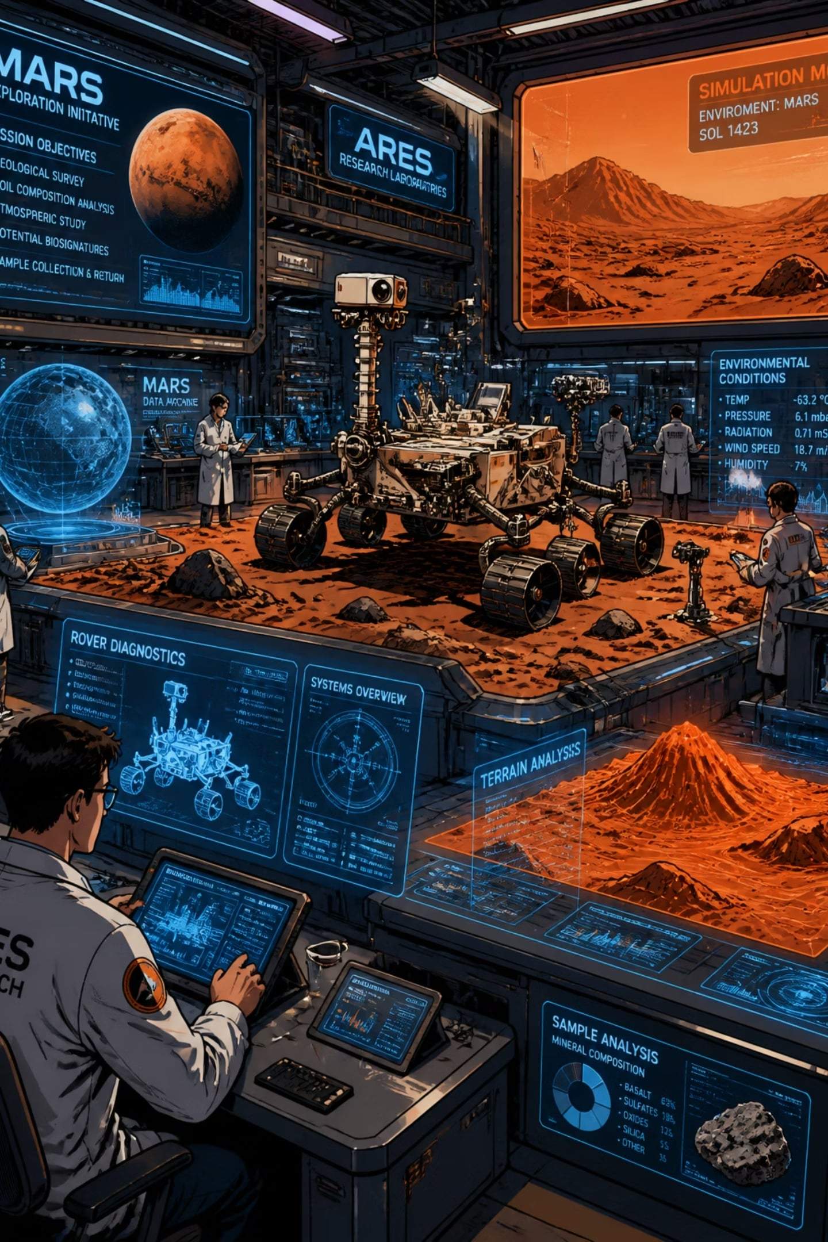
2. CORE OPERATIONAL PILLARS & PRODUCT PORTFOLIOS
B. Deep-Space Research & Planetary Exploration Support
Space Flight and Rover Simulation Environments
Providing advanced astrophysical modeling, space radiation assessments, and planetary atmospheric interaction simulations to evaluate hardware designs for upcoming lunar and Mars surface rovers.
Distributed Radio Astronomy Frameworks
Setting up a wide-baseline network of low-cost radio telescopes across national universities to conduct structural research on binary stars, deep-space pulsars, and galactic emission frequencies.

Slide 41



2. CORE OPERATIONAL PILLARS & PRODUCT PORTFOLIOS
C. Public Astro-Economy: Education & Tourism
PILLAR 1
PILLAR 2
Dark-Sky Reserve Designations
Immersive Astro-Tourism Products
Mobile Observatory Educational Fleets
PILLAR 3
Providing specialized spatial consulting to mega-projects (such as NEOM, AlUla, and The Red Sea) to secure international dark-sky certifications, protecting the environment while creating prime geographic footprints for stargazing.
Developing turn-key observatory experiences, cloud-linked amateur astrophotography stations, and automated stargazing applications tailored to luxury eco-tourism resorts.
Deploying a fleet of connected, vehicle-mounted mobile educational observatories equipped with digital smart telescopes and virtual reality space simulators to cultivate the next generation of space scientists across regional schools.

Slide 42

3. TRAINING, CONSULTATIONS, AND STRATEGIC ADVISORY
3
Training, Consultations, and Strategic Advisory
To establish the country as the definitive regional astronomical authority, NAOL will operate a commercial knowledge transfer and engineering advisory wing.
A. Professional Training & Community Development
PILLAR 1
Space Sciences & Analytics Academy
Offering rigorous professional training programs centered on space data processing, deep-space telemetry analysis, and radio signal engineering.
PILLAR 2
Astro-Tourism Operational Certification
PILLAR 3
Providing formal training and qualification tracks for local tour guides and hospitality operators to specialize in dark-sky management, telescope operations, and night-sky storytelling.

Slide 43

3. TRAINING, CONSULTATIONS, AND STRATEGIC ADVISORY
B. Strategic Astronomical Consulting
Telescope Architecture Advisory
PILLAR 1
Serving as the state's prime technical consultant to inspect, engineer, calibrate, and repair precision optical systems, custom lens tracking rigs, and high-altitude observatory assets for public and private enterprises.
PILLAR 2
Astrophysical Risk Mitigation Studies
PILLAR 3
Providing custom advisory reports assessing solar radiation storms, space weather threats, and cosmic ray impacts to safeguard commercial satellite infrastructure and communication networks.

Slide 44
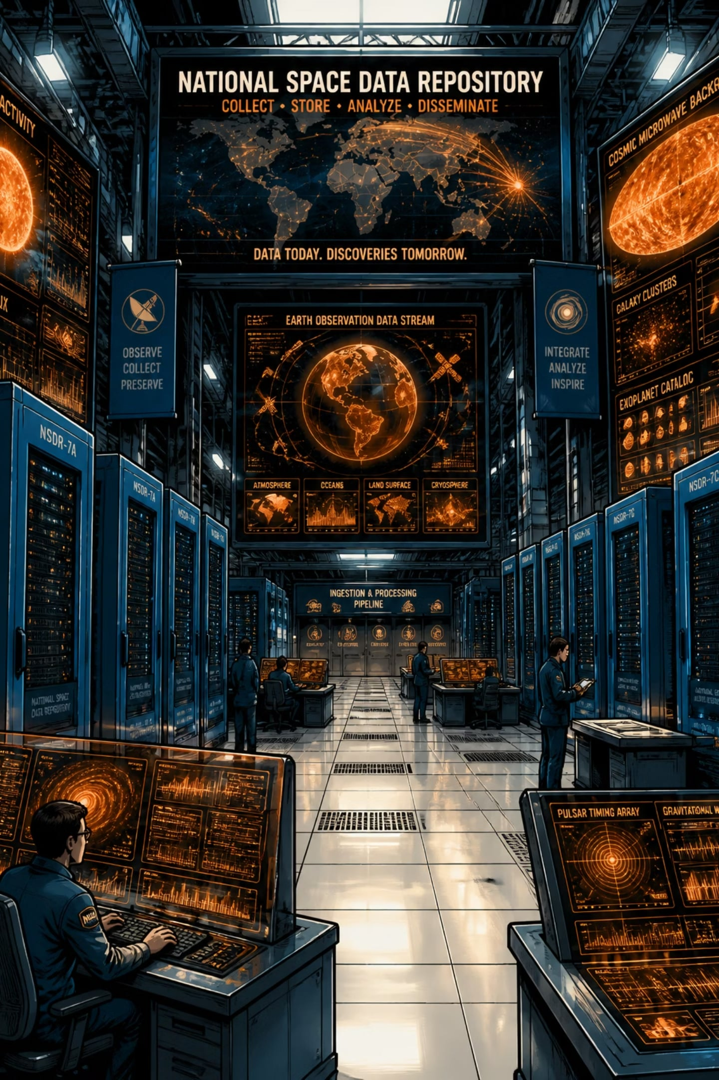
3. TRAINING, CONSULTATIONS, AND STRATEGIC ADVISORY
C. Research Sandboxes & Academic Alignment
PILLAR 1
The National Deep-Space Data Repository
Delivering a continuous, un-siloed flow of planetary, space debris tracking, and deep-space raw data to local research centers, maximizing the count of domestic patents and high-tier space exploration publications.
PILLAR 2
PILLAR 3
Amateur Astronomy Integration Tracks
Organizing structured alignment programs with the Saudi Radio Amateur Society and local science clubs to crowd-source celestial tracking data, building a robust, nationwide network of space science enthusiasts.

Slide 45
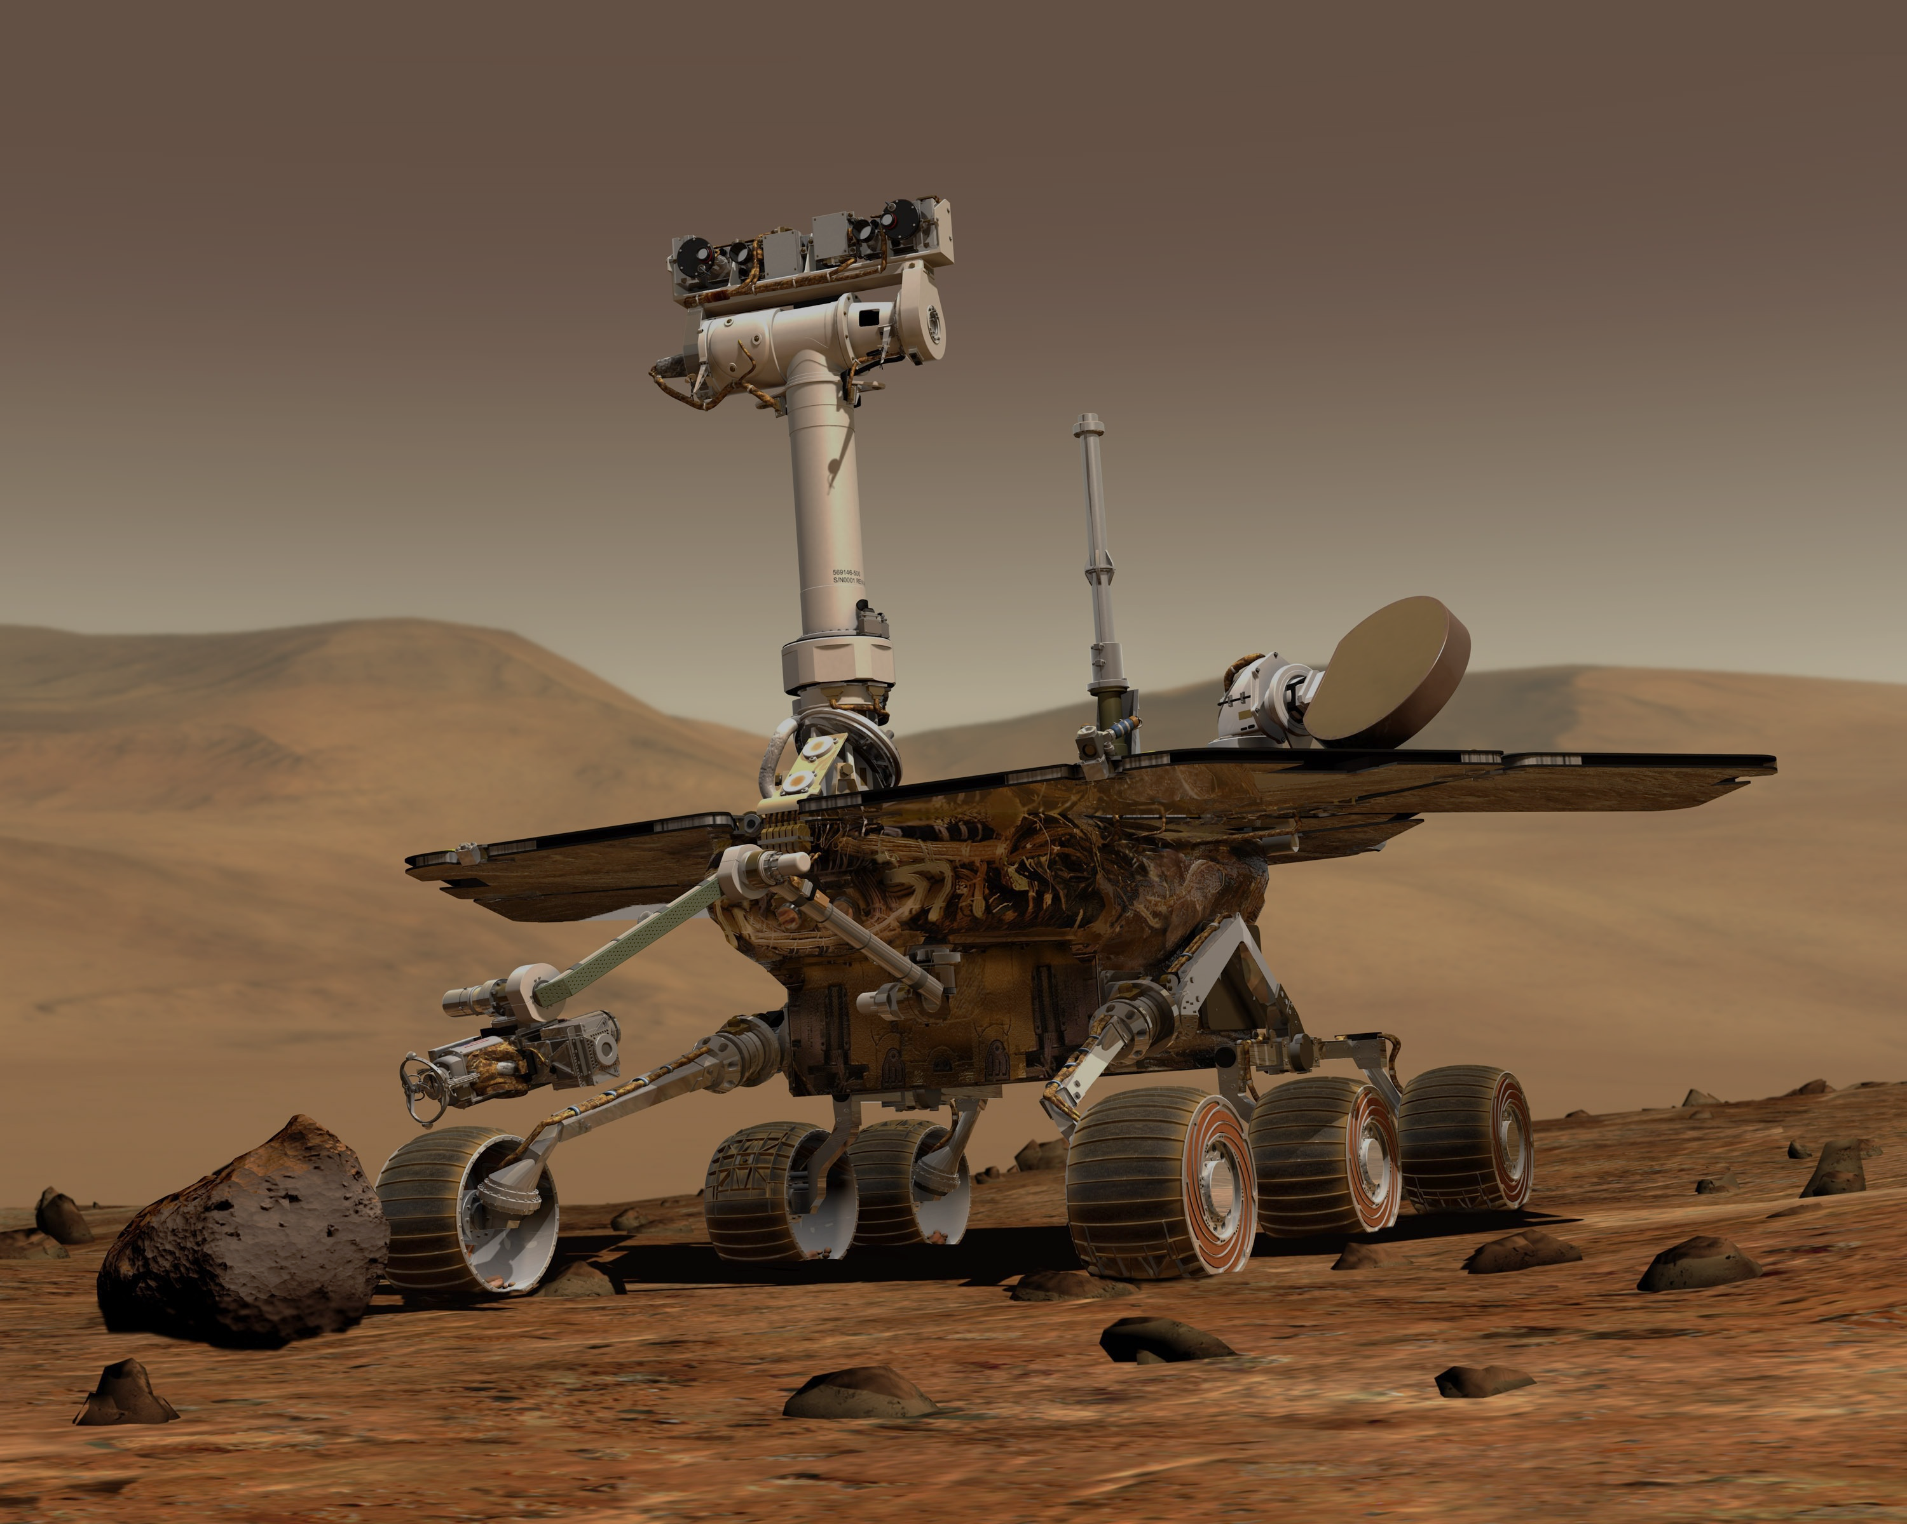
03
Business & Sustainability
Commercialization & Technology Transfer
PPP Model
Financial Model
Research & Growth Strategy

Slide 46
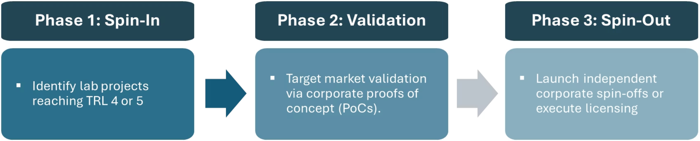
Commercialization and Dual-Use Localization
To unlock non-oil GDP contributions and support high-value national industrialization, IESS must aggressively deploy explicit technology transfer protocols.
The Accelerating Research to Commercialization (ARC) Program
IESS will institute an internal ARC framework designed specifically to bridge the gap between applied laboratory research and market deployment:
IP Commercialization Structure
Retain a baseline equity stake or continuous royalty stream for KACST on all patented technology transfers, generating an independent revenue fund to subsidize future exploratory research projects.

Slide 47
Operational Model: Public-Private Partnerships (PPP)
KACST – IESS ANCHOR
Core Laboratories & Facilities.
Master Satellite Archives
Cleanrooms & environmental Testing Infrastructure
A shift from a pure cost-center state budget model to an asset-backed growth vehicle requires a flexible PPP framework that leverages private sector efficiency and capital.
Joint Venture Framework &
Data Licensing Infrastructure
Private Enterprise Alliance
Defense & industrial Consortia (SAMI, Aramco, etc.)
International Space Technology Operators
Commercial Venture Capital Partnerships

Slide 48
Strategic Co-Investment Mechanisms
Data-for-Equity Infrastructure Programs
Tiered Service Contracts
Co-Developed Shared Laboratories
Partner directly with local industrial champions (such as SAMI, Aramco, and STC) to build specialized technology centers within KACST facilities. Under this framework, KACST supplies the baseline cleanroom space, testing chambers, and research personnel, while corporate partners fund specialized manufacturing machinery, computing stacks, and commercial engineering salaries.
Provide domestic and international space-tech startups with free processing time and raw satellite imagery access within the IESS National Remote Sensing Lab. In return, KACST secures a non-dilutive equity percentage in the startup, or options for exclusive domestic licensing rights to any software tools developed.
Offer guaranteed, long-term Service Level Agreements (SLAs) directly to corporate entities for operational site monitoring, resource extraction surveys, and regional infrastructure tracking. Private organizations fund the upfront deployment costs of dedicated micro-satellite constellations in exchange for guaranteed data access, transforming space R&D into a predictable, cash-flowing business model.

Slide 49

Financial Model and Revenue Projections
The strategic financial target of achieving 200 to 250 million SAR in annual revenues by 2030 is anchored by a diversified B2B and B2G product-mix, shifting away from a public funding model.
Target Revenue Sourcing Breakdown (2030 Projections)
NEOL Products → 40%
80M – 100M SAR — Analytics APIs, Change-Detection, Audits
NGSL Products → 35%
70M – 87.5M SAR — 3D/4D twins, HD Mapping, Subsurface Registries
NAOL Products → 10%
20M – 25M SAR — Moon Verification, Dark-Sky, Astro-Tourism
PPP & Knowledge Labs → 15%
30M – 37.5M SAR — Shared Lab Space, Professional Certifications

Slide 50
The Research and Growth (R&G) Strategy
While this strategy positions IESS as an agile commercial provider, its financial self-sustainability relies directly on maintaining a distinct R&G framework. We are not merely a geospatial service bureau; we are an asset-backed innovation engine.
Operational Mechanisms of the R&G Strategy
1
2
3
The Royalty Reinvestment Mechanism
Academic Co-Innovation Sandboxes
Dual-Use Localization Spillovers
Under the ARC framework, 15–20% of all ongoing licensing royalties and data-for-equity returns are routed directly into a protected internal exploration fund. This capital completely bypasses service operations and is used solely to finance low-TRL (TRL 1 to 3) exploratory deep-space and algorithmic research.
By maintaining open-data networks (The Geodata Vault, Deep-Space Repository), IESS crowdsources baseline exploratory data sorting to national university research pipelines. This saves operational computing costs while generating co-authored national patents and intellectual property assets that can be commercialized down the line.
Foundational defense-driven aerospace research into INS gyroscopes and secure LEO non-terrestrial cloud architectures expands domestic capabilities. These advancements cascade downward to establish cutting-edge commercial applications, ensuring that continuous innovation drives long-term commercial services.

Slide 51

04
Governance
Forward Strategic Recommendations
Organizational Structure

Slide 52
Forward Strategic Recommendations
To maximize the commercial viability and impact of this strategy, the board should integrate the following data tracks into the final proposal:
Comprehensive Workforce Capability Assessment
Global Market Pricing Framework
Regulatory Sandbox for Non-Terrestrial Testing
Action: Conduct a granular human resources capability audit to balance the existing technical footprint (e.g., mapping the current distribution of 19 PhDs and 297 engineers/technicians).
Objective: Identify specific skills gaps in AI algorithm design, non-terrestrial cloud engineering, and commercial space law, then resolve them through targeted global talent recruitment and exchange programs with corporate aerospace partners.
Action: Build a detailed market pricing and unit economics model for downstream geographic information systems (GIS) and value-added satellite data products.
Objective: Ensure the proposed commercial API endpoints are priced competitively against dominant global satellite data providers, while capturing higher regional margins by highlighting superior resolution, local compliance, and uncompromised national data independently.
Action: Partner with CST to establish a dedicated, permanent national regulatory testbed and sandbox for experimental satellite communications and high-frequency space observation systems within the Kingdom.
Objective: Attract international space technology pioneers by offering streamlined, rapid deployment authorizations and experimental spectrum access, positioning KACST as the primary destination for real-world space technology verification in the region.

Slide 53
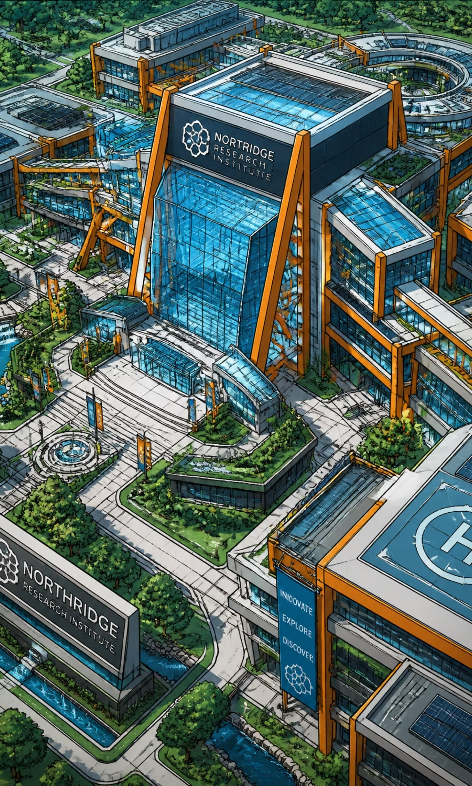
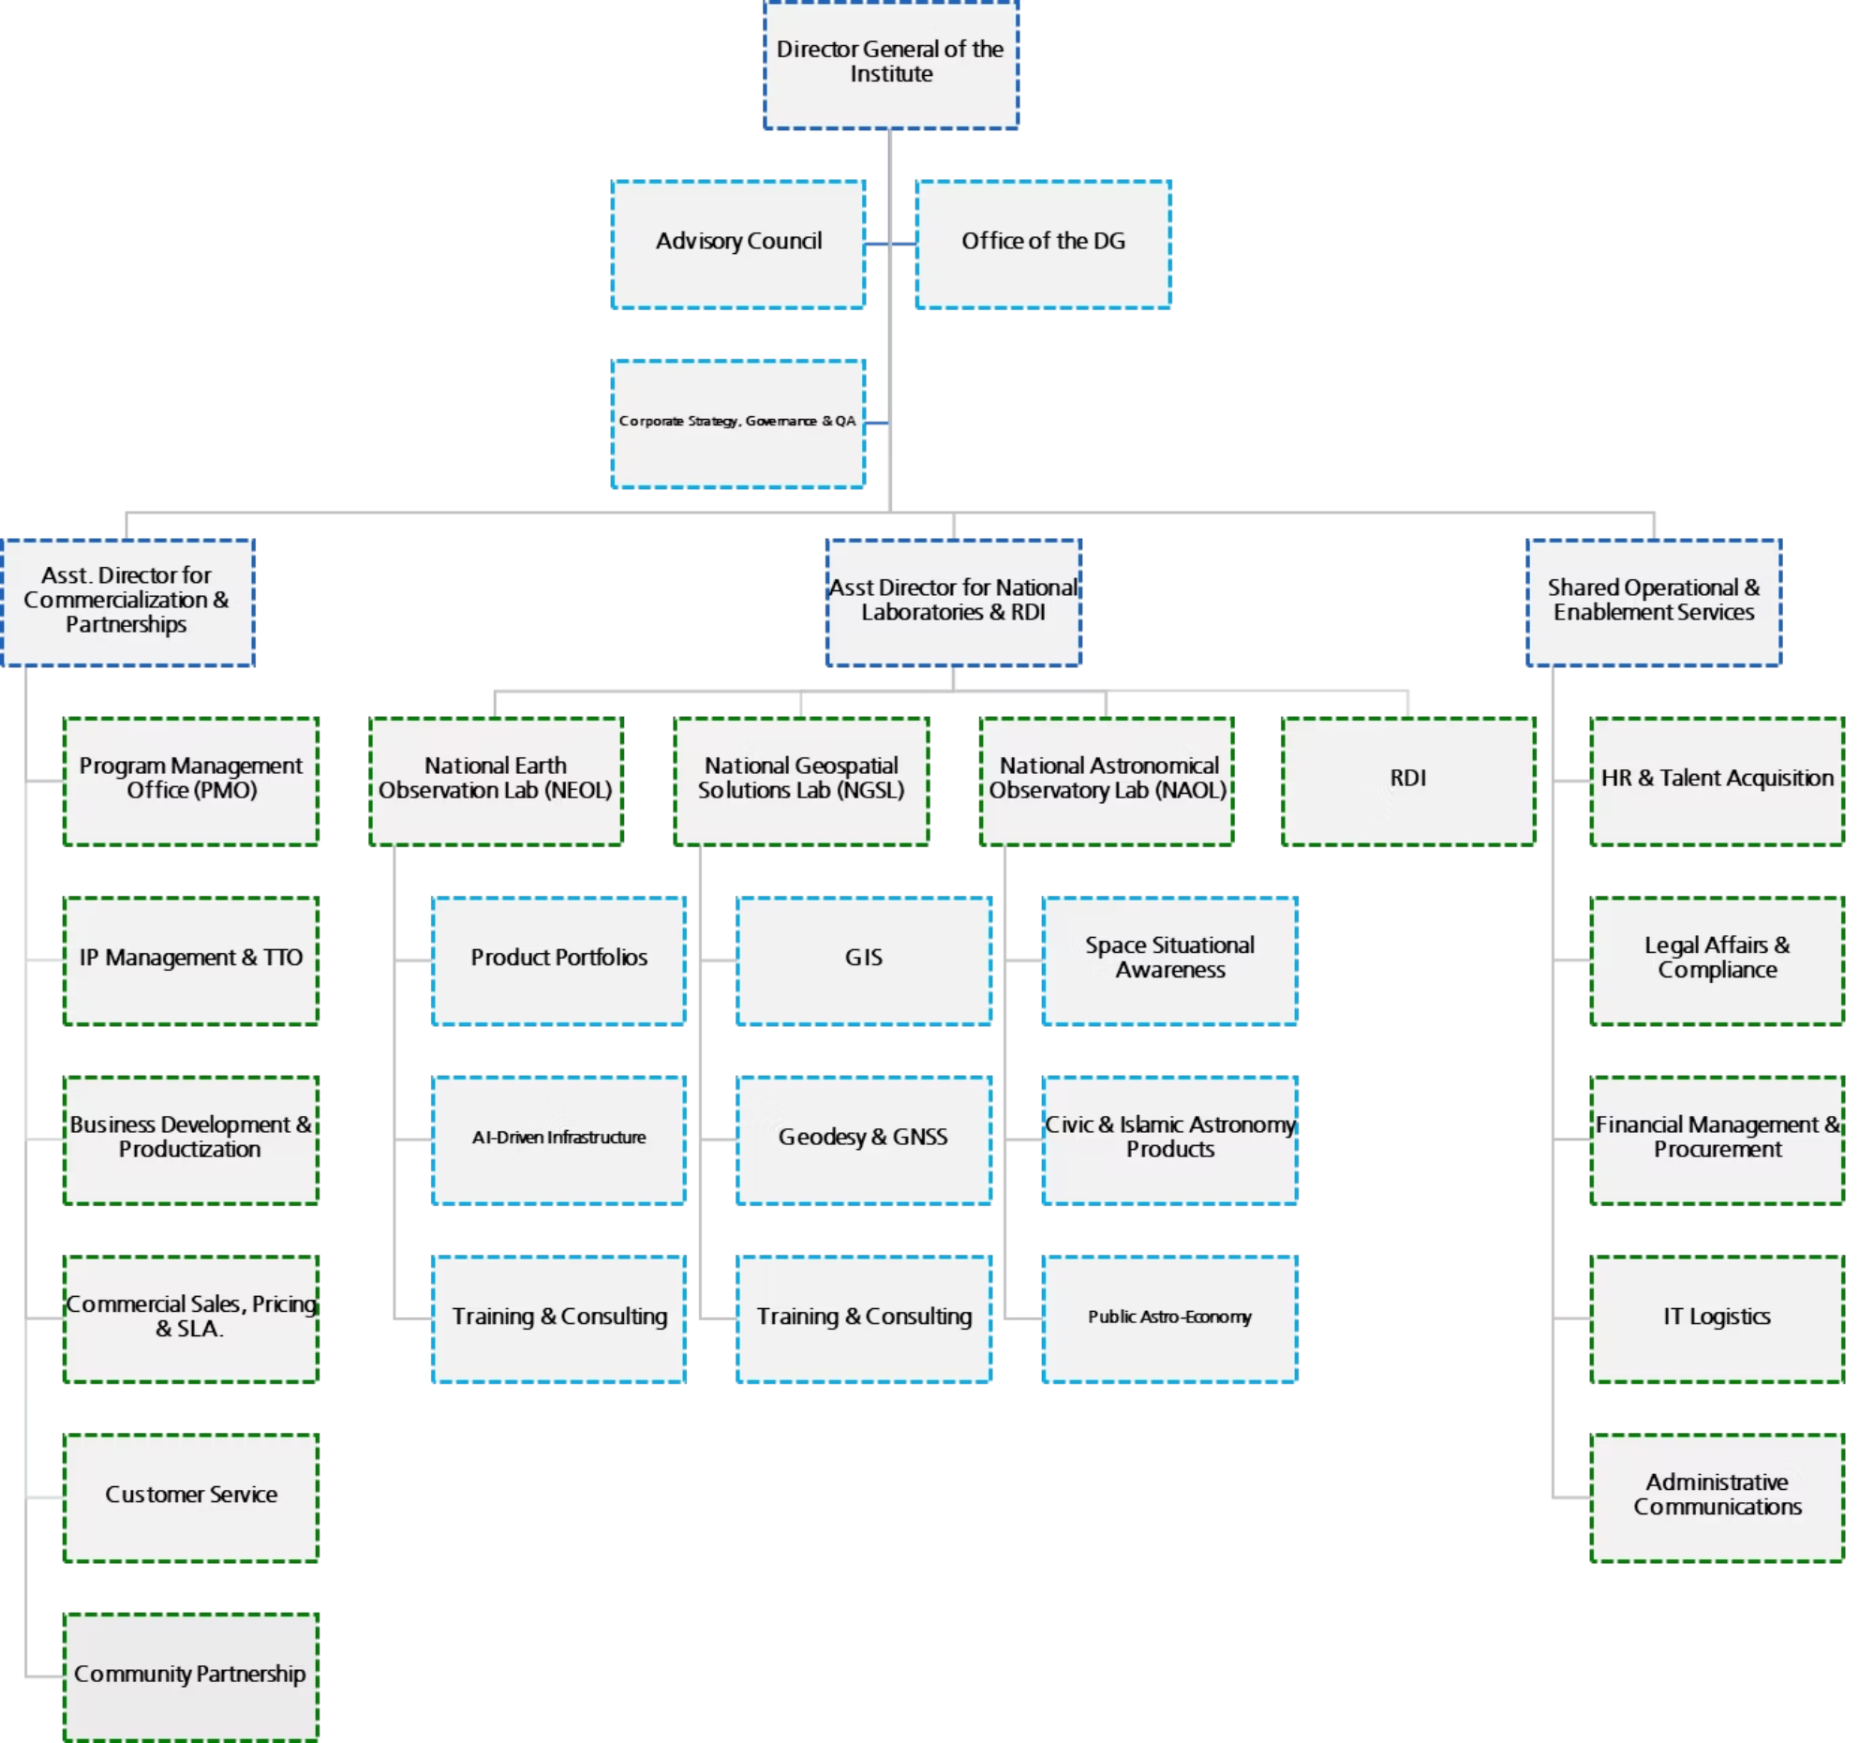
Organizational Structure
The restructured hierarchy below bridges the gap between technical capability and market execution, ensuring every strategic objective is backed by a dedicated operational owner.

Slide 54
DIVISION 1
Leadership & Advisory Functions
1.1 Director General of the Institute
1.1.1 Advisory Council
The top executive leader responsible for the overall strategic direction, decision-making, and management of the institute.
A group of external or internal experts providing strategic guidance, feedback, and recommendations to the Director General.
1.1.2 Corporate Strategy, Governance & QA
1.1.3 Office of the DG
Oversees long-term planning, organizational compliance, policies, and Quality Assurance (QA) standards.
The administrative support unit handling scheduling, communications, and executive coordination for the Director General.

Slide 55
DIVISION 2A
2A Commercialization & Partnerships Division
2A.1 Asst. Director for Commercialization & Partnerships
2A.1.1 Program Management Office (PMO)
2A.1.2 IP Management & TTO
Protects intellectual property (IP) and manages the Technology Transfer Office (TTO) to transition research into commercial products.
The executive leader responsible for the Commercialization & Partnerships Division.
Manages and governs specific high-priority programs and projects to ensure they are delivered on time and within budget.
2A.1.3 Business Development & Productization
2A.1.4 Commercial Sales, Pricing & SLA
2A.1.5 Customer Service
Manages relationships, inquiries, support, and overall satisfaction for the institute's clients and users.
Manages Public-Private Partnerships (PPPs) and shared business Joint Venture with external commercial or government entities.
Handles product pricing, sales strategies, and the creation of Service Level Agreements (SLAs) for institutional offerings.
2A.1.6 Community Partnership
Cultivates ties with the local community, educational entities, and public audiences through outreach and collaborative initiatives.

Slide 56
DIVISION 2B.1.1
2B National Laboratories & RDI Division
2B.1 Asst. Director for National Laboratories & RDI: The executive leader responsible for the for National Laboratories & RDI.
2B.1.1 National Earth Observation Lab (NEOL)
2B.1.1.1 Product Portfolios
Manages the specific commercial and data products generated by Earth observation activities.
Focuses on monitoring and analyzing Earth's physical, chemical, and biological systems via satellite and remote sensing data.
2B.1.1.2 AI-Driven Infrastructure
2B.1.1.3 Training & Consulting
Computer vision pipelines, deep learning foundations, and multi-modal data fusion.
Provides specialized educational programs and advisory services to external clients.

Slide 57
DIVISION 2B.1.2
National Geospatial Solutions Lab (NGSL)
Develops solutions based on geographic mapping, spatial data, and location intelligence.
2B.1.2.1 GIS
2B.1.2.2 Geodesy & GNSS
2B.1.2.3 Training & Consulting
Focuses on Geographic Information Systems mapping, data capture, and spatial analysis.
Focuses on filed survey and Ground Control Points (GCPs) and coordinates utilizing Global Navigation Satellite Systems (like GPS).
Offers mapping, GIS, and surveying training and consultancy to industry professionals.

Slide 58

DIVISION 2B.1.3 & 2B.1.4
2b1.3 National Astronomical Observatory Lab (NAOL)
Conducts space observations, telescope-based research, and astronomical tracking.
2B1.3.1 Space Situational Awareness
Tracks space debris, satellites, and near-Earth hazards to ensure safe space operations.
2B1.3.2 Civic & Islamic Astronomy Products
Develops tools and data for practical applications, such as lunar sighting calculations and prayer times.
2B1.3.3 Public Astro-Economy
Promotes public awareness, tourism (Astrotourism), and economic ventures rooted in astronomy.
2B1.4 RDI
Core Research, Development, and Innovation department driving scientific breakthroughs and new methodologies.

Slide 59
DIVISION 2C
2C Shared Operational & Enablement Services
2C.1 Shared Operational & Enablement Services Manager — The executive leader responsible for providing the infrastructure needed for the institute to run smoothly.
2C.1.1 HR & Talent Acquisition
2C.1.2 Legal Affairs & Compliance
2C.1.3 Financial Management & Procurement
Manages hiring, onboarding, employee relations, payroll, and professional development.
Handles contracts, provides legal counsel, and ensures operations conform to national and international regulations.
Oversees budgeting, accounting, asset management, and the purchasing of equipment and supplies.
2C.1.4 IT Logistics
2C.1.5 Administrative Communications
Manages the technological infrastructure, network operations, hardware distribution, and digital security.
Oversees internal documentation, incoming/outgoing official correspondence, and archival records.

Slide 60
Thank You
www.kacst.gov.sa

